Slide 1
Thinking about the Israel / Palestine dispute
Francis Holland School - Regent’s Park
Mohammed Amin MBE FRSA MA FCA AMCT CTA(Fellow)
19 September 2017

Slide 2
Synopsis
The speaker
Taking sides
Brief history
The situation today
Where next?
Discussion

Slide 3
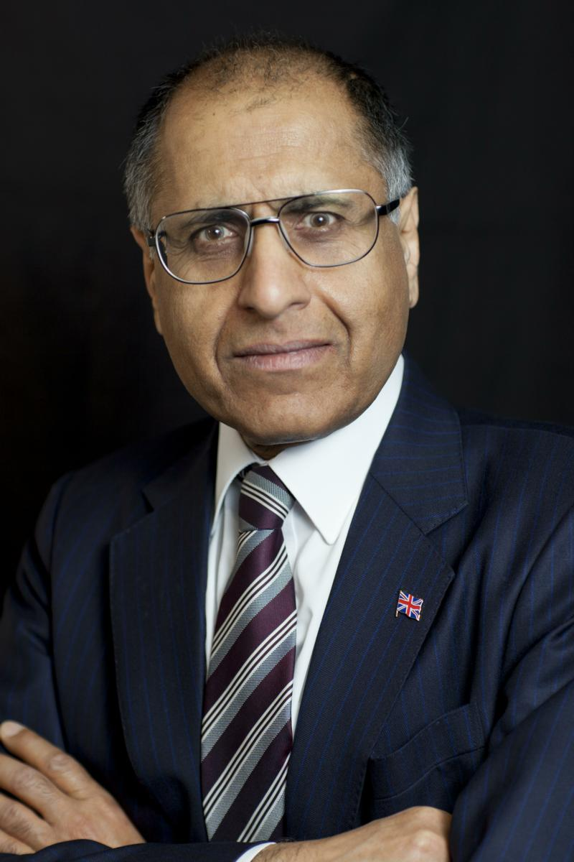
Mohammed Amin
Mohammed Amin has lived in the UK since the age of 2. He graduated in mathematics from Cambridge University and before retirement was a tax partner in PricewaterhouseCoopers.
Amongst other things, he is:
  Co-Chair of the Muslim Jewish Forum of Greater Manchester
  Chairman of the Conservative Muslim Forum, part of the Conservative Party
  On 10 June 2016 he was awarded an MBE in the Queen’s Birthday Honours List for services to Community Cohesion and Inter-faith Relations in Greater Manchester
www.mohammedamin.com
Slide 3

Slide 4
Taking sides
Slide 4

Slide 5
People have strong opinions
My tweet @mohammed_amin 19 June 2017 at 23:44
“I enjoyed attending iftar hosted by Israeli Ambassador Mark Regev at his residence this evening. Good mix of Muslims and Jews present.”
Similar Facebook status update
Twitter and Facebook responses?
Slide 5

Slide 6
Taking sides – some generalisations
Pro - Israeli | Pro - Palestinian
Jews | Muslims
Christian Zionists | Many other Christian groups
Political Left – in past | Political Left - today
Political Right | Former colonial subjects
Slide 6

Slide 7
Brief history
Slide 7

Slide 8
A partial short history of the Jews
Jews spread throughout Roman Empire. Judaism was a proselytising religion until rise of Christianity.
  “The Invention of the Jewish People” by Shlomo Sand
Christian rule ➔ Jews treated unequally until European enlightenment.
Muslim rule ➔ Jews treated unequally.
Major pogroms in Russia starting ~ 1880.
Largest ethnic / religious group in Jerusalem ~1850
Slide 8

Slide 9
Modern Zionism – two seminal books
“Der Judenstaat” = “The Jewish State” by Theodor Herzl
  Palestine or Argentina
  No mention of inhabitants
  https://www.mohammedamin.com/Reviews/The-Jewish-State.html
“Altneuland” = “Old New Land” by Theodor Herzl
  Fiction
  Joyous harmonious future
  https://www.mohammedamin.com/Reviews/Altneuland.html
Slide 9

Slide 10
Some 20’th century events (1)
1917 – British conquer Palestine from Ottoman Empire
1917 – Balfour Declaration. “The Balfour Declaration: The Origins of the Arab-Israeli Conflict” by Jonathan Schneer .
1929 – Hebron massacre
1936-1939 – Arab revolt
1937 – British partition plan (map)
1947 – UN partition plan (map)
1948 – War of Independence (map)
1967 – Six Day War
Slide 10

Slide 11
Some 20’th century events (2)
1973 – Yom Kippur war
1979 – Egypt / Israel peace treaty
1982 – Israel / Lebanon war
1987 – Founding of Hamas
1993 – Oslo accords
1994 – Jordan / Israel peace treaty
2000 – Start of second Intifada (Uprising)
Slide 11

Slide 12
Hamas (Islamic Resistance Movement)
The Covenant of the Islamic Resistance Movement 18 August 1988 on Yale Law School website http://avalon.law.yale.edu/20th_century/hamas.asp
May 2017 update on Middle East Eye website http://www.middleeasteye.net/news/hamas-charter-1637794876
Slide 12

Slide 13
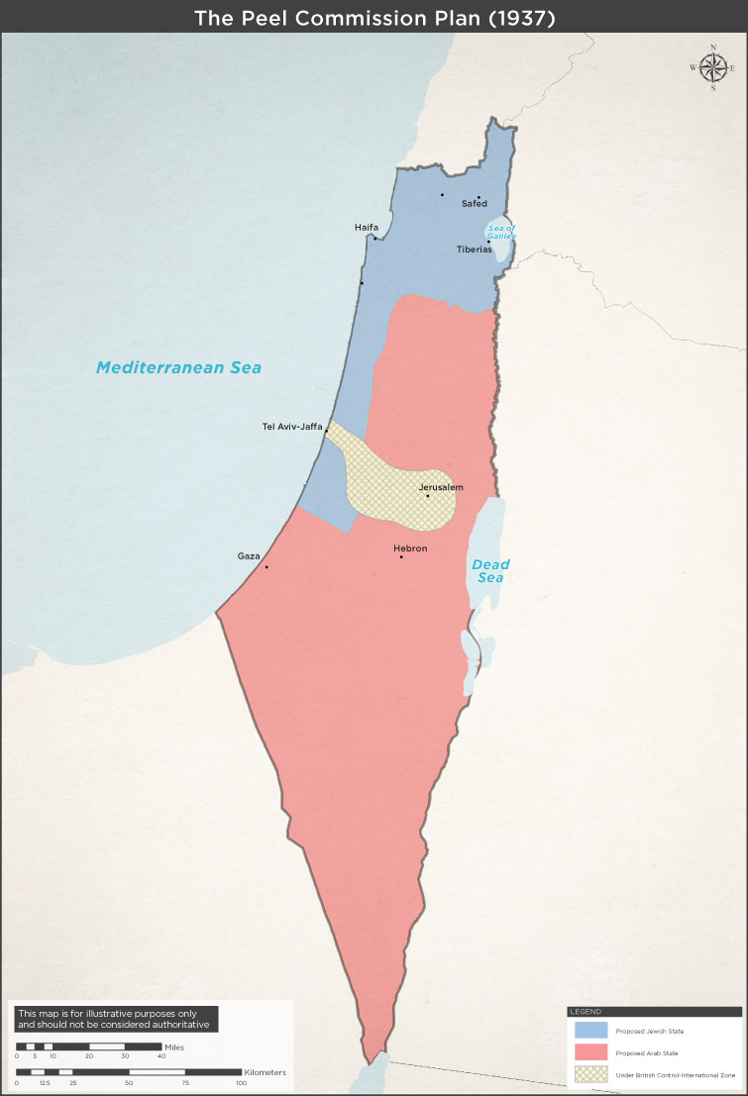
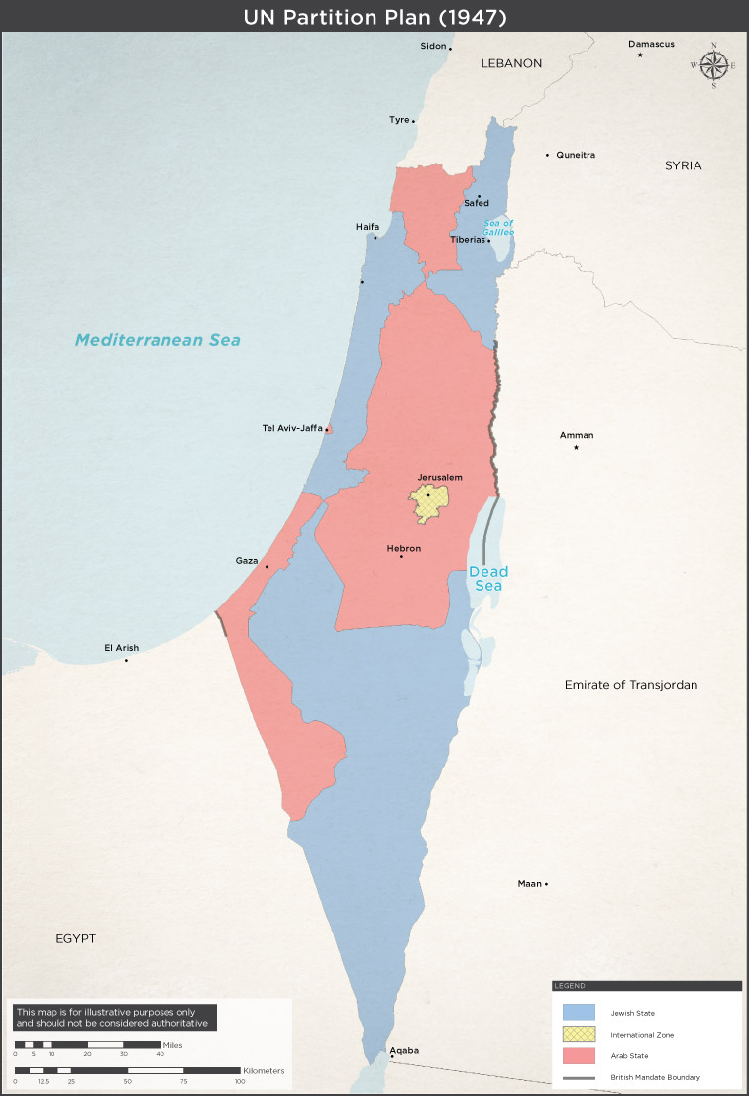
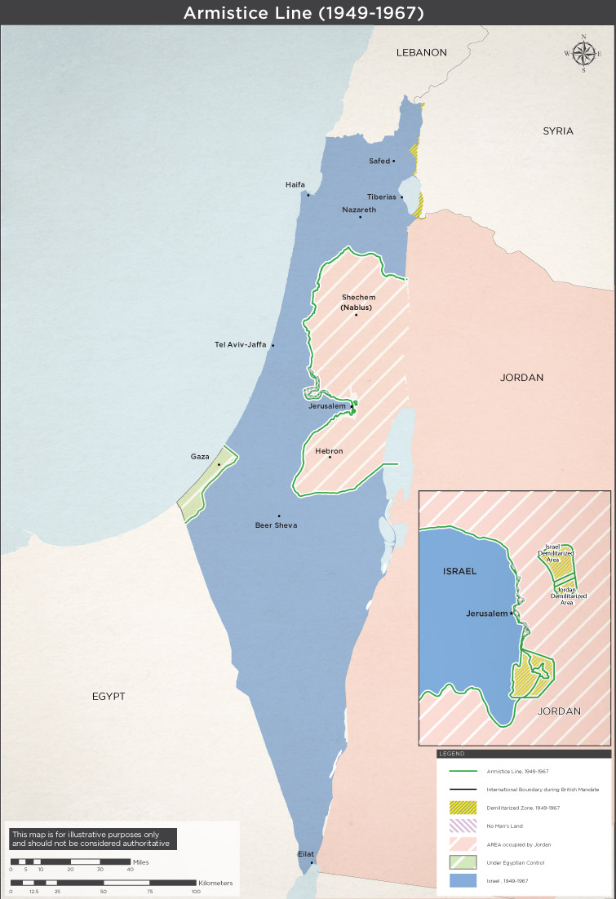
Three maps
Slide 13

Slide 14
The situation today
Slide 14

Slide 15
Approximate population numbers
Israel, population ~ 8.5m, 75% Jewish, 20% Muslim, 5% other.
Palestinians:
  West Bank 2.8m
  Gaza 1.8m
  Diaspora ~6m, mainly in Arab states
Slide 15

Slide 16
Where next?
Slide 16

Slide 17
Conflicting objectives
Maximalist Jewish claims to all of Palestine
Maximalist Muslim (Hamas) claims to all of Palestine
Israel’s desire to retain Jewish majority
Palestinians’ desire to return to ancestral homes
500,000+ Israeli West Bank settlers want to remain there
Jewish and Muslim connections with holy places:
  Jerusalem but also others like Hebron
Israel’s wish to remain a democracy
Slide 17

Slide 18
Discussion

