Slide 1
Advanced Microsoft Word
United Kingdom Shareholders’ Association
Mohammed Amin MBE FRSA MA FCA AMCT CTA(Fellow)
13 July 2021

Slide 2
Outline
Avoiding disaster
The speaker’s word processing history
The mental model
Some specifics
Managing multiple contributors / editors
Q & A
2

Slide 3
Avoiding disaster
Before doing anything important, save the document with a new file name.
To avoid confusion, I recommend using dates, such as “Thesis updated 25 June 2021.docx.”
Store really important documents in multiple places, including cloud drives and offline.
Plan for loss of computer and house fires.
3

Slide 4
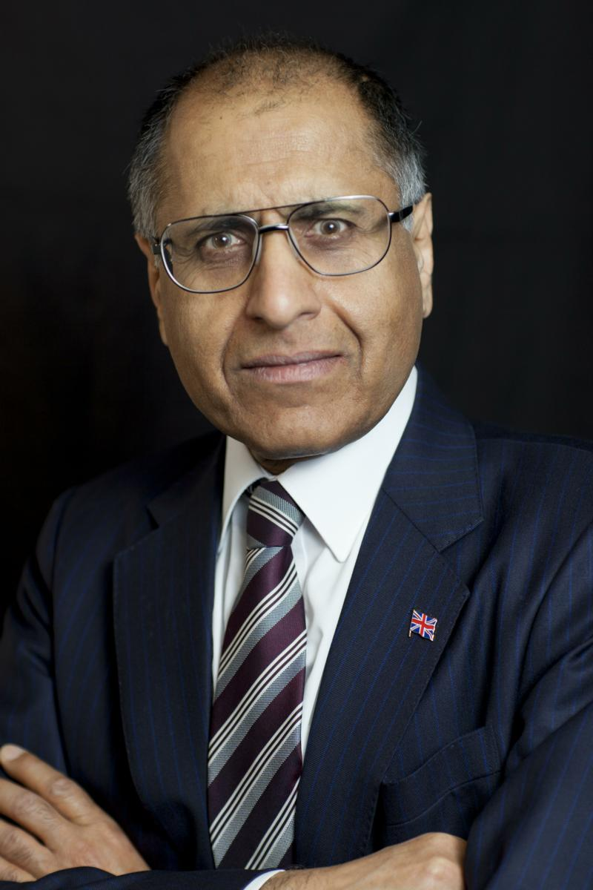
Mohammed Amin
  First word processing program owned, ~1983 was “The Final Word” from The Mark of the Unicorn.
  Not WYSIWYG ➔ learn structural concepts
  Major learning experience:
  CIOT Fellowship Thesis written 1997-1999.
  www.mohammedamin.com
4

Slide 5
The mental model
5

Slide 6
Small documents
Document
Paragraphs
Sentences
Words
Characters
6

Slide 7
Big documents
Document
Every Thing has a style
Sections
Header
Footer
Body
Thing
Thing
Thing
Thing
Thing
Separately formatted region inside a Thing
7

Slide 8
A style is a bundle of properties
Thing
Style A
Thing
Style B
All “Things” of the same style have the same properties
To change how they look, edit the style
Thing
Style A
Thing
Style B
Thing
Style A
Thing
Style B
8

Slide 9
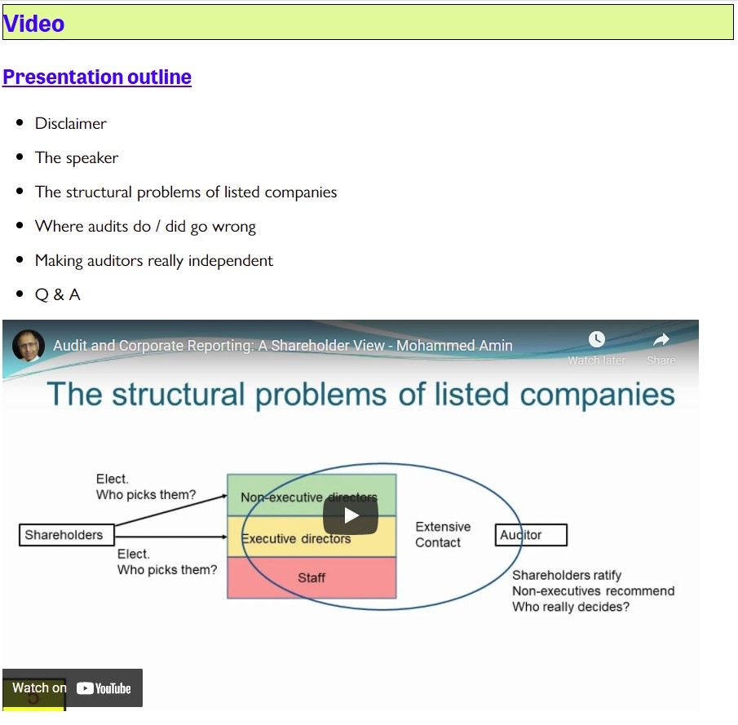
Website page example
9

Slide 10
Website page HTML
<h2 align="left">Video</h2> Level 2 heading
<h3 align="left">Presentation outline</h3> Level 3 heading
<ul> Begin unordered list
<li>Disclaimer </li> List item
<li>The speaker </li>
<li>The structural problems of listed companies </li> List item
<li>Where audits do / did go wrong </li> List item
<li>Making auditors really independent </li> List item
<li>Q &amp; A </li> List item
</ul> End unordered list
<iframe loading="lazy" width="854" height="480" src="https://www.youtube.com/embed/Sbr4u-DEL2c" title="YouTube video player" frameborder="0" allow="accelerometer; autoplay; clipboard-write; encrypted-media; gyroscope; picture-in-picture" allowfullscreen></iframe> Embedded frame
10

Slide 11
Recommended approach
How do I want the document to look?
I want to do X.
How do I do X?
  Word help file – not very good!
  Ask question on Google search – works brilliantly most of the time.
11

Slide 12
Some specifics
12

Slide 13
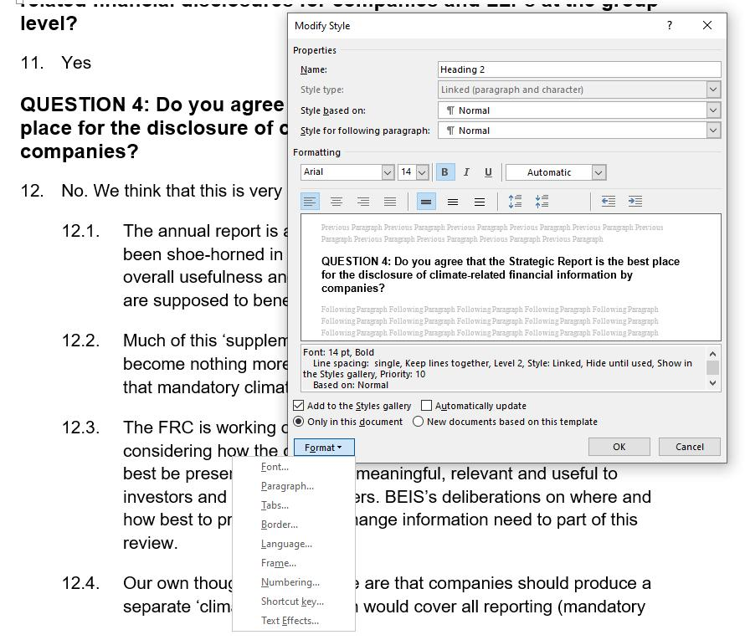
Editing a style
Style = a collection of properties
Complete control
Name means nothing
“NumNormal” name invented by me as reminder based on “Normal” style
Can copy styles between documents
13

Slide 14
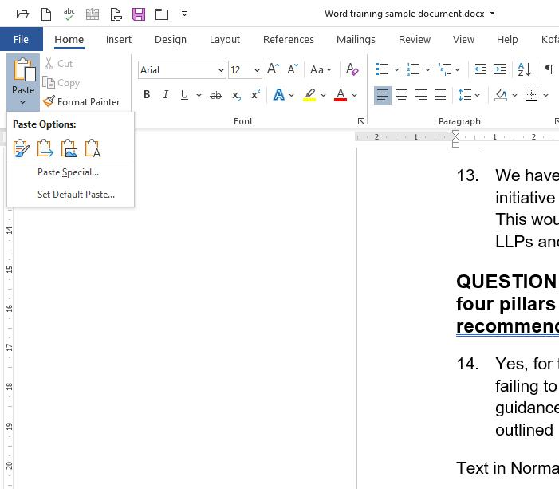
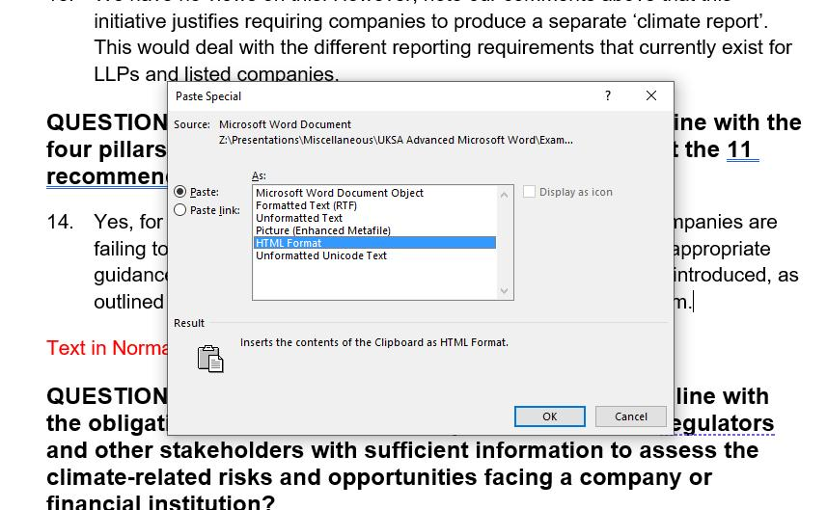
Pasting involves choices
Basic paste options
Paste special
14

Slide 15
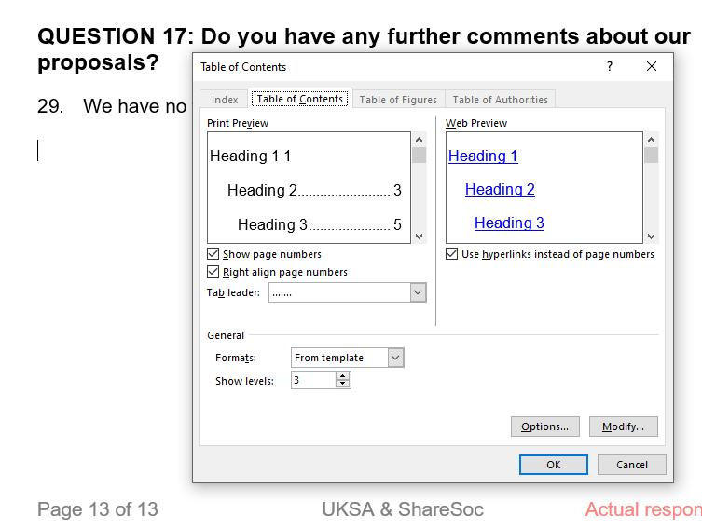
Table of contents choices
Text ends up in TOC if give it Heading styles
How many TOC levels?
If don’t want text in TOC, don’t give it an included Heading style
15

Slide 16
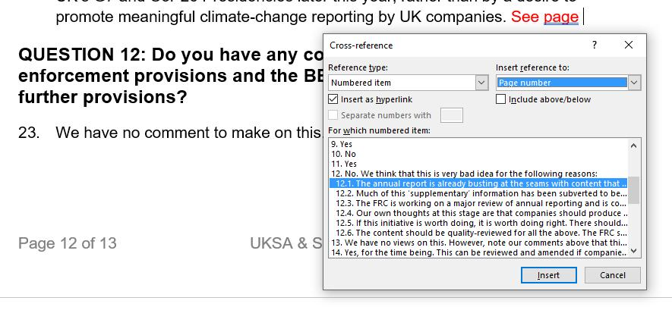
Cross-reference choices
Decide what you want to reference
Will you cite its number or its page?
16

Slide 17
Managing multiple contributors / editors
17

Slide 18
Lead Author, many colleagues
Single source, multiple contributors / editors
  Word enables Lead Author to merge in each editor’s changed version, one at a time, accepting or rejecting changes.
Comparison tool
  Original v changed document
    Generates redlined comparison as output, even with no change tracking
Lead Author must stay in control or risk chaos!
18

Slide 19
Q&A
19

