Slide 1
Faith communities in Greater Manchester + The role of the Muslim Jewish Forum
The Royal College of Defence Studies
Mohammed Amin MBE
Co-Chair
The Muslim Jewish Forum of Greater Manchester
6 December 2021

Slide 2
Synopsis
About the speaker
Greater Manchester’s diversity
The danger of parallel lives
Muslims and Jews in the UK – facts and common interests
The Muslim Jewish Forum of Greater Manchester
Design choices
Why it works
What it has done for the speaker
Cllr Heather Fletcher
2

Slide 3
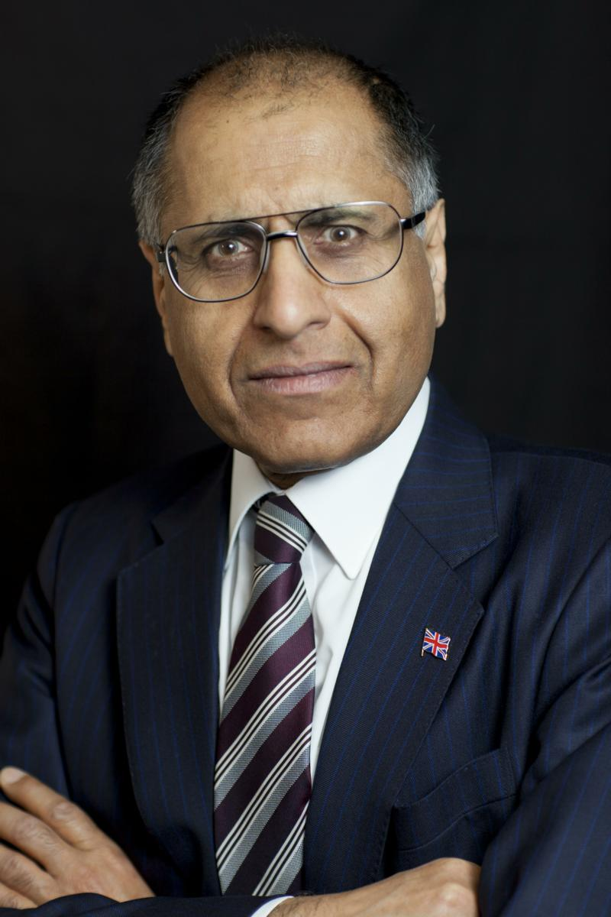
Mohammed Amin MBE
Mohammed Amin has lived in Manchester since the age of 2. He graduated in mathematics from Cambridge University and before retirement was a tax partner in PricewaterhouseCoopers.
Amongst other things, he is:
Co-Chair of the Muslim Jewish Forum of Greater Manchester
Chairman of the Islam & Liberty Network, based in Kuala Lumpur
A trustee of The National Muslim War Memorial Trust
An early donor to the British Muslim Heritage Centre
For more about the Forum and the speaker, visit:
www.muslimjewish.org.uk
www.mohammedamin.com
3

Slide 4
Greater Manchester’s diversity
4

Slide 5
Manchester’s ethnicity 2011
Ethnic Group | Percentage
White / Irish / Traveller | 66.6
Mixed Race | 4.6
Indian | 2.3
Pakistani | 8.5
Bangladeshi | 1.3
Chinese | 2.7
Other Asian | 2.3
African / Caribbean / Other Black | 8.6
Other ethnic group (includes Arab) | 3.1
5

Slide 6
Manchester’s religious groups 2011
Religious group | Percentage
Christian | 62.42
Buddhist | 0.55
Hindu | 0.73
Jewish | 0.78
Muslim | 9.12
Sikh | 0.43
Other religions | 0.28
No religion | 15.97
Religion not stated | 9.72
6

Slide 7
The danger of parallel lives
7

Slide 8
My grammar school
2
150
8

Slide 9
Some schools today
150
2
9

Slide 10
Television and video
My youth
1-4 channels
All in English
About life in UK
Today
Endless number of channels
Many in foreign languages
About life elsewhere
10

Slide 11
We make our future
High contact
Low contact
No contact
11

Slide 12
Muslims and Jews in the UK: facts and common interests
12

Slide 13
Facts
 | Jews | Muslims
Census 2011 England & Wales | 263,000 | 2,700,000
Main period of immigration | 1880 - 1920 | 1960 - 2016
Conversions in | Few | Significant
Parliamentary representation | Proportionately high. Static? | Proportionately low. Growing.
Average educational standards | High | Low. Rising.
Ethnic diversity | Low | Very high
13

Slide 14
Demographic profiles
14

Slide 15
Common interests (1)
The right to hold religious beliefs
The right to manifest religious practices
The retention of religious humane methods of animal slaughter for food in the United Kingdom and Europe
The right for young people to be educated in faith schools and to have their religion respected in mainstream schools
15

Slide 16
Common interests (2)
The retention of male circumcision
The right to have religious observances respected by public bodies and the wider community
The provision of acceptable methods of post mortem examinations
Reproduced from Muslim Jewish Forum declaration of principles
16

Slide 17
Design choices + Why it works
17

Slide 18
Two key design choices
Purpose
Israel & Palestine?
Membership
Religious leaders?
18

Slide 19
Purpose – 100% domestic
“The objects for which the Forum is established are to develop the cultural and social ties between the Muslim and Jewish Communities of Greater Manchester; to educate members of the Muslim and Jewish Communities in relation to their shared values and common Abrahamic tradition, heritage, history and culture; maximising their potential and improving their health and well-being as residents of Greater Manchester; and to promote better understanding within the wider community of the interests and values that are common to the Muslim and Jewish Communities.”
MJF’s Memorandum of Association
19

Slide 20
Membership
All members are equal
No special role for religious leaders
No special role for civic representatives
Everybody is a grass root!
Parity on Executive, two Co-Chairs
Everybody is volunteer
Runs on a shoestring
20

Slide 21
Why it works
Runs on a shoestring
Avoids financial pressures
Accountable to nobody
Put on events that the members like attending
Limited objectives
Get Muslims and Jews in Greater Manchester to get to know each other while attending things
Avoid the divisive Israel / Palestine issue
“not in Greater Manchester”
21

Slide 22
What it has done for the speaker: - goals - by products
22

Slide 23
Goals
My life story ➔ God has been incredibly generous to me
Gratitude ➔ Helping others in Manchester, UK and the world
1-1 Mentoring
Running or supporting organisations
Writing, speaking in person, media
Bringing Greater Manchester Muslims & Jews together is part of that
23

Slide 24
By products
Gained friends in Manchester, both Jews and Muslims
Got to know many national Jewish leaders
Travelled in Europe with Forum (at own expense!)
Learned much about Israel & Palestine, been there twice (not with Forum)
MBE “Founder Member and Co-Chair, Muslim Jewish Forum of Greater Manchester. For services to Community Cohesion and Inter-faith Relations in Greater Manchester.”
24

Slide 25
Co-Chair Cllr Heather Fletcher
25

