Slide 1
My perspective on Hamas
Liberal Democrats for Peace in the Middle East
Mohammed Amin MBE FRSA MA FCA AMCT CTA(Fellow)
7 September 2026

Slide 2
Outline
The presenter
What is Hamas?
Hamas in their own words
  1988 Covenant
  2017 A Document of General Principles & Policies
  2025 Our Narrative…Al Aqsa Flood
Hamas and the Israeli government
Where I stand
Discussion
2

Slide 3
The presenter
3

Slide 4

Mohammed Amin
Mohammed Amin was born in 1950 in Pakistan but has lived in Manchester since 1952. He has visited Israel and the West Bank twice: in December 2009 / January 2010, and in November 2018.
He supports many Israel / Palestine related NGOs and charities and has written and spoken extensively about the conflict. See his website www.mohammedamin.com
He is:
Chair of LDfPME
Co-Chair of the Muslim Jewish Forum of Greater Manchester
He is speaking in a personal capacity.
4

Slide 5
What is Hamas?
5

Slide 6
ح حركة المقاومة الإسلامية
Arabic script
Transliteration
Harakat al-Muqawama al-Islamiya
Abbreviated
Hamas
Translation
Islamic Resistance Movement
Religiously based group
6

Slide 7
Contrast
Organisation | Meaning
PLO | Palestine Liberation Organisation
Fatah | Harakat al-Tahrir al-Watani al-Filastini = Palestinian National Liberation Movement
PFLP | Popular Front for the Liberation of Palestine
7

Slide 8
Hamas in their own words
1988 Covenant
8

Slide 9
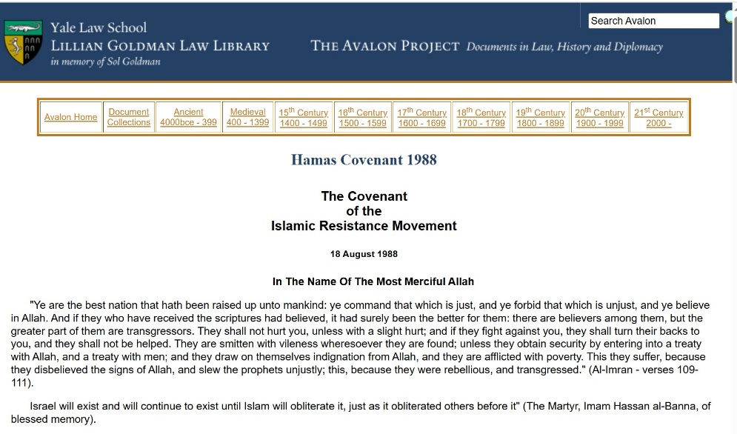
Hamas’s founding document
9,220 words,
14 pages A4
https://avalon.law.yale.edu/20th_century/hamas.asp
https://irp.fas.org/world/para/docs/880818.htm
9

Slide 10
Article Four
The Movement welcomes all Muslims who share its beliefs and thinking, commit themselves to its course of action, keep its secrets and aspire to join its ranks in order to carry out their duty. Allah will reward them.
10

Slide 11
Article Seven: The Universality of Hamas
… the Movement is a universal one…. the Hamas has been looking forward to implement Allah’s promise whatever time it might take. The prophet, prayer and peace be upon him, said: The time will not come until Muslims will fight the Jews (and kill them); until the Jews hide behind rocks and trees, which will cry: O Muslim! there is a Jew hiding behind me, come on and kill him! This will not apply to the Gharqad, which is a Jewish tree (cited by Bukhari and Muslim).
https://www.mohammedamin.com/Community_issues/Persecution-Muslim-religious-texts.html
11

Slide 12
Article Eleven: The Strategy of Hamas: Palestine is an Islamic Waqf
The Islamic Resistance Movement believes that the land of Palestine has been an Islamic Waqf throughout the generations and until the Day of Resurrection, no one can renounce it or part of it, or abandon it or part of it. … The ownership of the land by its owners is only one of usufruct, and this Waqf will endure as long as Heaven and earth last. Any demarche in violation of this law of Islam, with regard to Palestine, is baseless and reflects on its perpetrators.
12

Slide 13
Article Thirteen: Peaceful Solutions, [Peace] Initiatives and International Conferences
[Peace] initiatives, the so-called peaceful solutions, and the international conferences to resolve the Palestinian problem, are all contrary to the beliefs of the Islamic Resistance Movement. For renouncing any part of Palestine means renouncing part of the religion;… There is no solution to the Palestinian problem except by Jihad. The initiatives, proposals and International Conferences are but a waste of time, an exercise in futility….
13

Slide 14
Article Twenty-Two: The Powers which Support the Enemy
The enemies have been scheming for a long time,… and accumulated … wealth… This wealth [permitted them to] take over control of the world media such as news agencies, the press, publication houses, broadcasting and the like. [They also used this] wealth to stir revolutions in various parts of the globe in order to fulfill their interests and pick the fruits. They stood behind the French and the Communist Revolutions… it has come to pass and no one objects, that they stood behind World War I, so as to wipe out the Islamic Caliphate…. They obtained the Balfour Declaration and established the League of Nations in order to rule the world by means of that organization. They also stood behind World War II…
14

Slide 15
Hamas in their own words
2017 A Document of General Principles & Policies
15

Slide 16
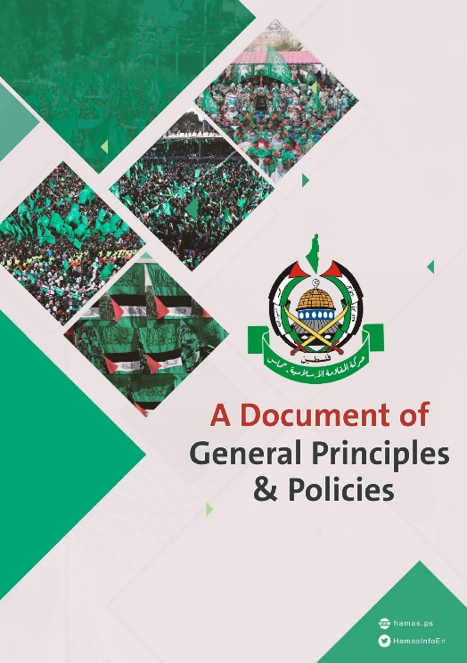
2017 Document
Issued 1 May 2017 in Doha by Hamas leader Khalid Meshal
Does not revoke the 1988 Hamas Covenant
11 pages A4
https://www.palquest.org/en/historictext/24219/islamic-resistance-movement-hamas-document-general-principles-and-policies
16

Slide 17
The Land of Palestine – clause 2
Palestine, which extends from the River Jordan in the east to the Mediterranean in the west … is an integral territorial unit. It is the land and the home of the Palestinian people. The expulsion … and the establishment of the Zionist entity therein do not annul the right of the Palestinian people to their entire land and do not entrench any rights therein for the usurping Zionist entity.
17

Slide 18
The position toward Occupation and Political Solutions – 18 & 19
The following are considered null and void: the Balfour Declaration, the British Mandate Document, the UN Palestine Partition Resolution, and whatever resolutions and measures that derive from them or are similar to them. The establishment of “Israel” is entirely illegal…
There shall be no recognition of the legitimacy of the Zionist entity…
18

Slide 19
The Palestinian Political System - 27
A real state of Palestine is a state that has been liberated. There is no alternative to a fully sovereign Palestinian State on the entire national Palestinian soil, with Jerusalem as its capital.
19

Slide 20
Hamas in their own words
2025 Our Narrative…Al Aqsa Flood
20

Slide 21

2025 Our Narrative … Al Aqsa Flood
Issued December 2025
Al Aqsa Flood = Hamas name for 7 October 2023 attack
42 pages A4
https://almoqawma.com/2025/12/24/7908/
21

Slide 22
Chapter 3 – Yes to Uncovering the Truth (1)
… the Israeli entity attempted to distort the truth. It launched a global disinformation machine,…, to transform the legitimate military operation—which targeted the Israeli army’s Gaza Division, a military unit that had perpetuated killing and siege against Gaza—into claims about targeting civilians and children.
22

Slide 23
Chapter 3 – Yes to Uncovering the Truth (2)
we affirm the following:
• Killing civilians is not part of our religion, morality, or education; and we avoid it whenever we can.
23

Slide 24
Chapter 3 – Yes to Uncovering the Truth (3)
Serious Israeli journalistic and media investigations have admitted that the Israeli army bombed areas where Israeli civilians were intermixed with Al-Qassam mujahideen (fighters), as part of what is known as the «Hannibal» procedure aimed at preventing the potential capture of Israeli soldiers. It has also been revealed that a large number of reserve soldiers and conscripts were wearing civilian clothes or were off military duty during the attack.
24

Slide 25
Hamas and the Israeli government
25

Slide 26

Recommended book
“Once Upon a Country: A Palestinian Life” by Sari Nusseibeh
Former president of Al-Quds University, Jerusalem and former representative of the Palestinian National Authority in Jerusalem.
Key message: Israeli government consistently favoured Hamas to weaken moderate Palestinians working for peace.
26

Slide 27
Recommended newspaper: “Haaretz”
11 November 2018 – “Netanyahu: Money Transfer to Hamas Is the Right Step, I Know How to Bear the Cost”
20 October 2023 – “Opinion A Brief History of the Netanyahu-Hamas Alliance”
20 December 2023 – “Opinion How Netanyahu Enabled October 7 With Suitcases of Cash”
27

Slide 28
Where I stand
28

Slide 29
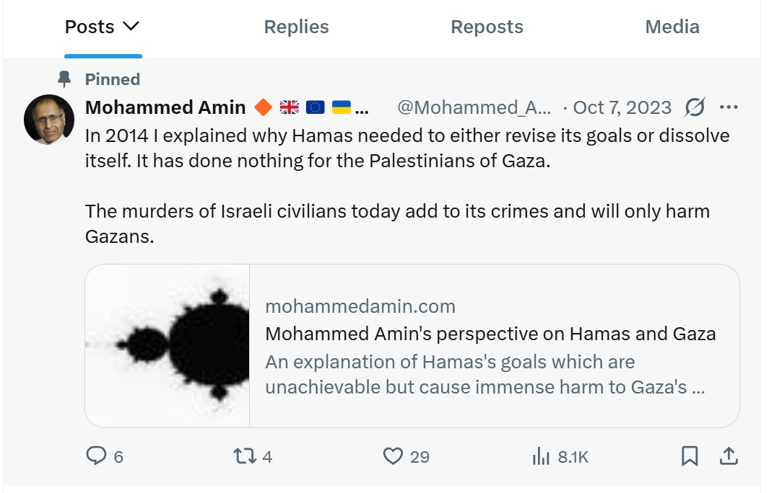
My pinned tweet issued 7 Oct 2023
29

Slide 30
Discussion
30

