Slide 1
UK Islamic Finance: The business opportunities
Habib Bank Zurich plc
Mohammed Amin MBE MA FCA AMCT CTA(Fellow)
9 January 2020

Slide 2
Disclaimer
Taxation and finance are complex subjects and almost all issues require specific professional advice.
Nothing in this presentation is intended to constitute professional advice.
The speaker accepts no responsibility to Habib Bank Zurich plc, or to anyone else, from acting, or refraining from acting, as a result of anything shown or said during this presentation.

Slide 3
Presentation outline
The presenter
Requested coverage
Presentation structure
Addressable market and its needs
Competitors
HBZ advantages and disadvantages
Learning from competitors
Discussion

Slide 4
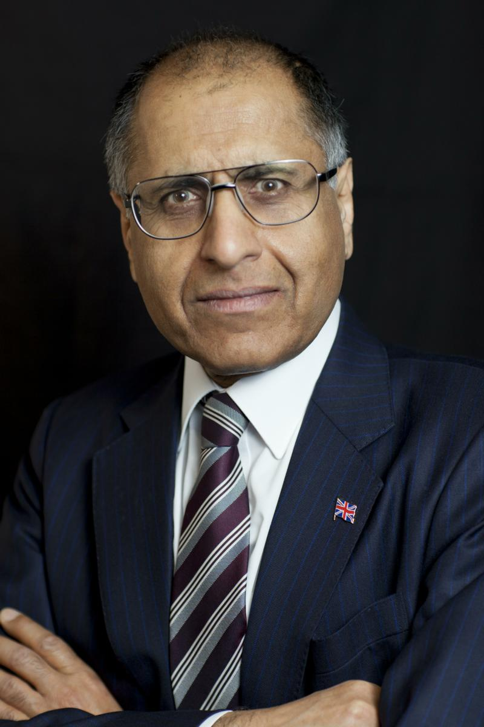
Mohammed Amin MBE
Mohammed Amin is an Islamic finance consultant. Previously he was a tax partner in PricewaterhouseCoopers LLP (the first Muslim partner in the UK in Price Waterhouse) and led their Islamic finance practice in the UK.
He graduated in Mathematics from Cambridge University and is:
a chartered accountant
a chartered tax adviser
a qualified corporate treasurer
Amin has spoken on Islamic finance in over 20 cities covering every continent except Antarctica. Many of his articles and presentations on Islamic finance can be found in the Islamic finance section of his website:
www.mohammedamin.com
Slide 4

Slide 5
Requested coverage
The Islamic banking landscape in the UK
Competitive scan
Opportunities and risks for a new bank entering the Islamic banking market
Lessons learnt
Slide 5

Slide 6
Addressable market and its needs

Slide 7
Market segments
Domestic
Retail
Corporate
Inward investors
Retail
Corporate
Slide 7

Slide 8
Domestic retail
Slide 8

Slide 9
Financial exclusions
Slide 9

Slide 10
Religious exclusions
Slide 10

Slide 11
Retail market: wants and needs
What people ask for | Needs often unmet
Residential mortgages | Equity savings products, ISAs
Current accounts | Pensions wrappers
Savings accounts | Insurance
Scope to sell white-label products
Slide 11

Slide 12
Corporate market
What people ask for | Needs often unmet
Business loans | Hedging FX risk
Property development finance | Hedging interest rate risk
Slide 12

Slide 13
Competitors

Slide 14
Who are they
Dedicated Islamic banks
Retail
Corporate
Windows of foreign conventional banks from OIC countries
Windows of UK conventional banks
Slide 14

Slide 15
Retail Islamic banks
Al Rayan Bank - was Islamic Bank of Britain
Domestic retail focus
ADIB (UK) – subsidiary of Abu Dhabi Islamic Bank
Focus on inbound HNW individuals
Slide 15

Slide 16
Corporate Islamic banks
Bank of London and the Middle East
Rasmala – was European Islamic Investment Bank
Gatehouse
QIB (UK) – subsidiary of Qatar Islamic Bank
Slide 16

Slide 17
Results from start to 31 Dec 2018
Name | Cumulative losses £’m | Cumulative capital increases (net of repurchases) £’m
Al Rayan was IBB | - 31 | 120
ADIB (UK) | - 22 | 58
BLME | - 21 | 255
Rasmala was EIIB | - 66 | 141
Gatehouse | - 40 | 150
QIB (UK) | - 21 | 86
Slide 17

Slide 18
Windows of conventional banks
UK conventional banks
HSBC closed down HSBC Amanah in UK
Lloyds minor offering
May be others
No easily available financial data
International Islamic banking desks for sukuk issues, derivatives etc
Foreign conventional banks
Minor presence for HNWI
Slide 18

Slide 19
HBZ advantages and disadvantages

Slide 20
Habib Bank Zurich window operation
Positives | Negatives
Minimal extra cost | Much less appealing to new customers.
Additional offering for existing customers
Slide 20

Slide 21
Learning from competitors

Slide 22
Lessons from competitors
Lessons | HBZ
Sub-scale banks (IBB, ADIB UK) attract deposits, but cannot earn much. Operating costs ≈ losses | Existing infrastructure minimises extra operating costs
Large capital ➔ Chasing business ➔ bad lending | Hopefully no need to chase new Islamic business
Asset management + wealth management opportunities | Capabilities?
Slide 22

Slide 23
Discussion

