Slide 1
Audit and Corporate Reporting: A Shareholder View
Control and Risk Self-Assessment Forum
Mohammed Amin MBE FRSA MA FCA AMCT CTA(Fellow)
21 April 2021

Slide 2
Outline
Disclaimer
The speaker
The structural problems of listed companies
Where audits do / did go wrong
Making auditors really independent
Q & A
2

Slide 3
Disclaimer
Amin is a member of the Policy Team of the United Kingdom Shareholders’ Association (UKSA).
He is speaking in a personal capacity.
None of his comments should be taken as indicative of the views of UKSA.
3

Slide 4
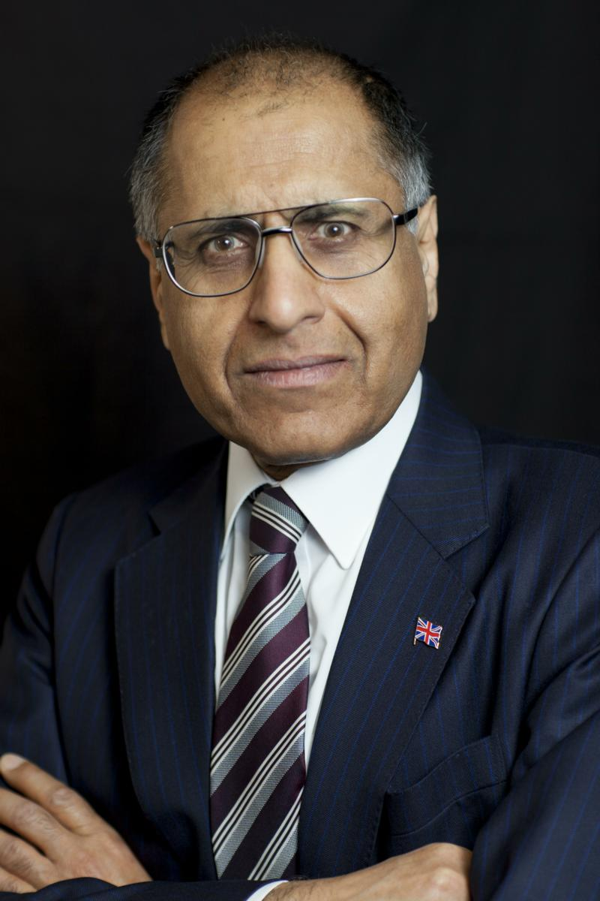
Mohammed Amin
A Price Waterhouse (now PwC) tax partner 1990-2009, he attended many audit committee meetings as part of the PwC audit team.
His client-side experience comes from serving on the audit committees of Salford University, Manchester Training & Enterprise Council, and PwC itself as a member of PwC’s Supervisory Board.
His writings on finance are on his website: www.mohammedamin.com
4

Slide 5
The structural problems of listed companies
Elect.
Who picks them?
Non-executive directors
Extensive Contact
Shareholders
Executive directors
Auditor
Elect.
Who picks them?
Staff
Shareholders ratify
Non-executives recommend
Who really decides?
5

Slide 6
Where audits do / did go wrong
Other work dwarfs audit
Enron
Largely solved by rules / market practice
Finish the job
Audit + audit related work ➔ always the auditor
Other work ➔ never the auditor
Management becomes the client
Law clear management isn’t, but not working
Who really fires the auditor?
When did shareholders last reject an audit change?
6

Slide 7
Make auditors really independent
Regulator appoints auditors
Regulator agrees the audit fee
7

Slide 8
Q&A
8

