Slide 1
Brexit and the rise of the far right
Challenging Hate Forum
Mohammed Amin MBE
3 October 2019

Slide 2
Outline
The speaker
Some hate crime data
Brexit supporters
What can we do?
Q&A
Slide 2

Slide 3
The speaker
Slide 3

Slide 4
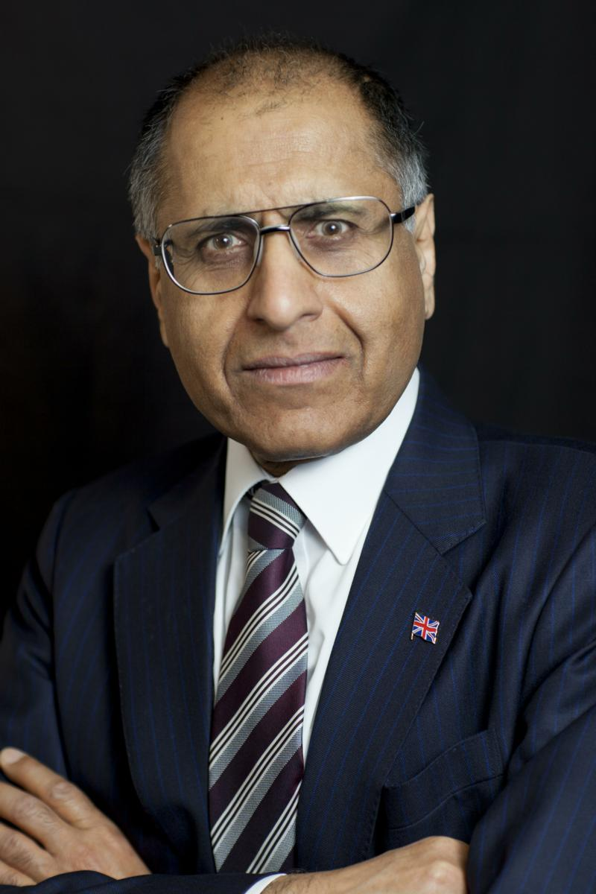
Mohammed Amin MBE
Mohammed Amin graduated in mathematics from Cambridge University and before retirement was a tax partner in PricewaterhouseCoopers.
Amongst other things, he is:
  Co-Chair of the Muslim Jewish Forum of Greater Manchester
  Chairman of the Islam & Liberty Network, based in Kuala Lumpur
  Chairman of Curriculum for Cohesion
  mohammedamin.com
Slide 4

Slide 5
Some hate crime data
Slide 5

Slide 6
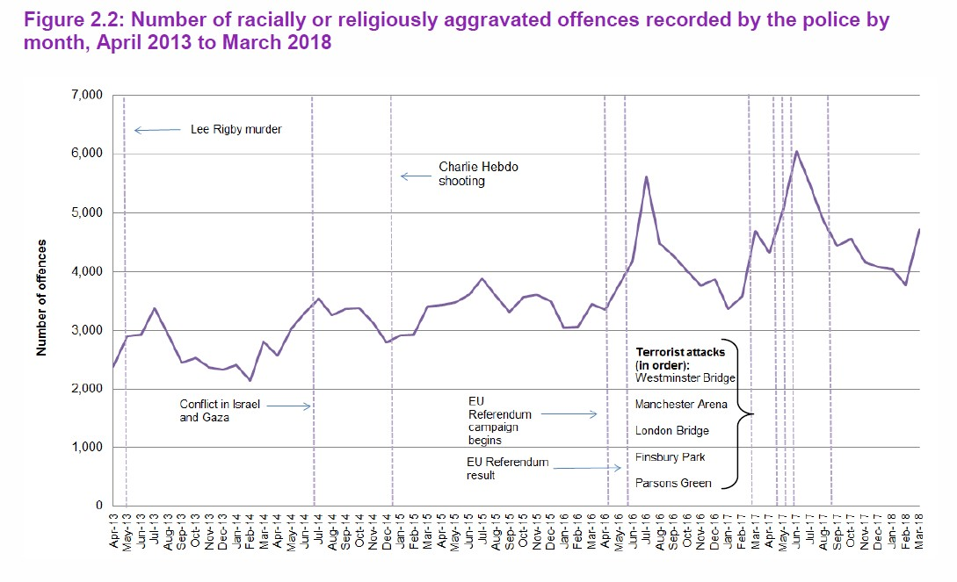
Source: Home Office Hate Crime, England and Wales, 2017/18
Slide 6

Slide 7
Brexit supporters
Slide 7

Slide 8
Brexit supporters differ
Daniel Hannan MEP & Tommy Robinson both supporters
Daniel Hannan
  Born in Peru
  Speaks Spanish and French
  Happy with immigration
  Liberal internationalist
Tommy Robinson
  Anti-Muslim white nationalist.
Slide 8

Slide 9
Detailed post referendum research
NATCEN Social Research
  British Social Attitudes Survey No. 34
    Chapter on Brexit by Sir John Curtice
    Leave and Remain voters differ, on average
      BSA excludes non-voters and “don’t remember how they voted”, for clarity
    Survey covers Britain
Slide 9

Slide 10
Age
Age range | Leave % | Remain %
18-24 | 28 | 72
65+ | 63 | 37
Slide 10

Slide 11
Highest educational qualification
 | Leave % | Remain %
Degree | 22 | 78
None | 72 | 28
Slide 11

Slide 12
Education ≠ surrogate for age
Highest educational qualification | Remain % 18-34 age | Remain % 55+ age
Degree | 80 | 70
GCSE or less | 37 | 30
Slide 12

Slide 13
Authoritarian / libertarian spectrum
Questions to assess these attitudes (see later)
Segment people by authoritarianism
  Most authoritarian 1/3
  Middle 1/3
  Least authoritarian 1/3
Slide 13

Slide 14
Authoritarian / libertarian scale
Scale consists of a number of statements to which the respondent is invited to:
  “agree strongly”
  “agree”
  “neither agree nor disagree”
  “disagree”
  “disagree strongly”
Slide 14

Slide 15
The questions
Young people today don’t have enough respect for traditional British values.
People who break the law should be given stiffer sentences.
For some crimes, the death penalty is the most appropriate sentence.
Schools should teach children to obey authority.
The law should always be obeyed, even if a particular law is wrong.
Censorship of films and magazines is necessary to uphold moral standards.
Slide 15

Slide 16
Authoritarian / libertarian voting patterns
 | Leave %
Most authoritarian | 72
Middle on this spectrum | 53
Most libertarian | 21
Slide 16

Slide 17
National identity
Which, if any, of the following best describes how you see yourself?
  English, not British,
  More English than British
  Equally English and British
  More British than English
  British, not English
Slide 17

Slide 18
Voting by national identity
 | Leave %
English, not British | 72
British, not English | 38
Slide 18

Slide 19
Summary and conclusion
Data tells us Leave voters
  Older
  Less well educated
  Authoritarian
  Prioritise their Englishness
Mohammed Amin’s conclusion
  Such people are much more likely to support far right groups
Slide 19

Slide 20
What can we do?
Slide 20

Slide 21
Encourage people to consume better news
Friends on social media ≠ reliable news source
All newspapers have some standards
Quality newspapers have higher standards
Consume sources you disagree with, not just those you agree with
Slide 21

Slide 22
Change our language
People pro / anti Brexit
  Both want the best for Britain
  Both are patriots
  Both need to comply with the law
  Both entitled to seek their political goals, but only by lawful means
Every person in Britain
  Has rights that must be respected
  Their presence helps all of us
Slide 22

Slide 23
Q & A
Slide 23

