Slide 1
Islam – A Religion of Peace
Nazarene Theological College
Mohammed Amin MBE FRSA MA FCA AMCT CTA(Fellow)
21 November 2017

Slide 2
Synopsis
The speaker
Scene setting: “A religion of peace?”
A religion v its adherents
Islam
  Structure of authority
  What I believe
  Abrogation
  Salafi-Jihadism
Bibliography
Q&A
Slide 2

Slide 3
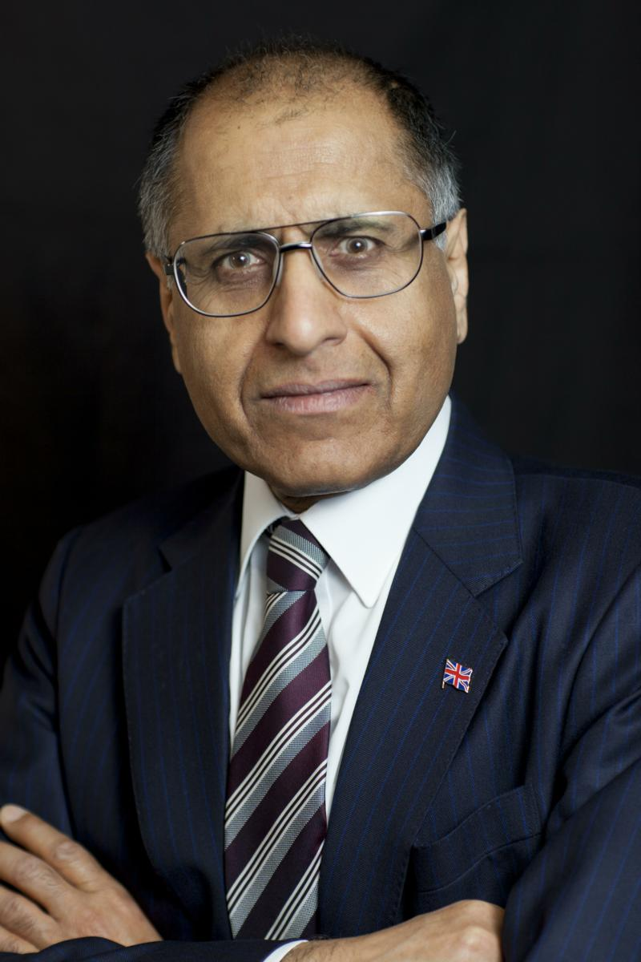
Mohammed Amin
Mohammed Amin has lived in the UK since the age of 2. He graduated in mathematics from Cambridge University and before retirement was a tax partner in PricewaterhouseCoopers.
Amongst other things, he is:
  Co-Chair of the Muslim Jewish Forum of Greater Manchester
  Chairman of the Conservative Muslim Forum, part of the Conservative Party
  A member of the Consultative Council of the Three Faiths Forum
  A Trustee of Curriculum for Cohesion
  A Council member of the Istanbul Network for Liberty
Most of his previous writings on religion and other topics are on his website:
www.mohammedamin.com
Slide 3

Slide 4
Scene setting:
“A religion of peace?”
Slide 4

Slide 5
Conflict with Jews at end of time
Allah's Apostle said,
"The Hour will not be established until you fight with the Jews, and the stone behind which a Jew will be hiding will say:
"O Muslim! There is a Jew hiding behind me, so kill him."
Bukhari Volume 4, Book 52, Number 177
Slide 5

Slide 6
Quoted today
The Prophet, Allah bless him and grant him salvation, has said:
"The Day of Judgement will not come about until Moslems fight the Jews (killing the Jews), when the Jew will hide behind stones and trees. The stones and trees will say O Moslems, O Abdulla, there is a Jew behind me, come and kill him. Only the Gharkad tree, (evidently a certain kind of tree) would not do that because it is one of the trees of the Jews." (related by al-Bukhari and Moslem).
Hamas Covenant of 1988, extract from Article 7
http://avalon.law.yale.edu/20th_century/hamas.asp
Slide 6

Slide 7
A religion v
Its adherents
Slide 7

Slide 8
Judaism
Jewish rule destroyed by Roman Empire
History ignores the Kingdoms of Himyar and the Khazars
~2,000 years of Rabbinic Judaism in exile
Growing religious influence in Israel from 1947?
Slide 8

Slide 9
Christianity
Persecuted minority religion until Emperor Constantine
"In this sign you will conquer“
European Enlightenment = struggle for freedom from religious control
State enforcement of Christianity now low, in most places
Slide 9

Slide 10
Islam
Persecuted minority while Prophet in Mecca
From 622 AD Prophet ruled mixed society in Medina
Arab conquests ➔ Arab empire
  Ottoman Empire
  Mughal Empire
Religious minorities in SE Asia ➔ majorities
19’th, 20’th centuries, conflicts between secularisation and increased religiosity
Slide 10

Slide 11
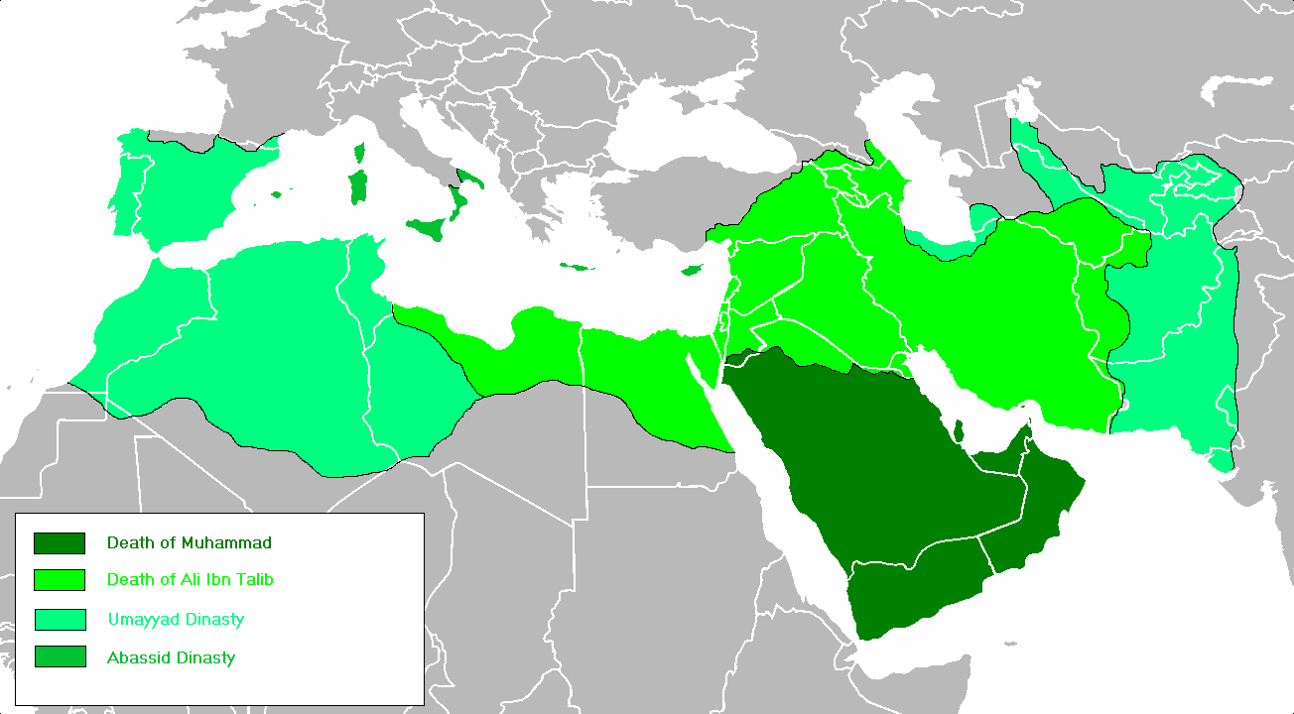
The Arab Empire - Wikimedia Commons
Slide 11

Slide 12
Quoted today
The Prophet, Allah bless him and grant him salvation, has said:
"The Day of Judgement will not come about until Moslems fight the Jews (killing the Jews), when the Jew will hide behind stones and trees. The stones and trees will say O Moslems, O Abdulla, there is a Jew behind me, come and kill him. Only the Gharkad tree, (evidently a certain kind of tree) would not do that because it is one of the trees of the Jews." (related by al-Bukhari and Moslem).
Hamas Covenant of 1988, extract from Article 7
http://avalon.law.yale.edu/20th_century/hamas.asp
Slide 12

Slide 13
Jewish refugees to Israel 1947-1957
Country | Refugees
Morocco | 260,000
Iraq | 129,290
Yemen and Aden | 50,552
Tunisia | 56,000
Algeria | 14,000
Iran | 31,000
Source: "In Ishmael’s House – A History of Jews in Muslim Lands" by Martin Gilbert
Slide 13

Slide 14
Christians in Middle East - Wikipedia
Country | Number
Egypt | 12-16 million in 2008 per Coptic claims
Iraq | About 1.6 million in 2003
Lebanon | Last official census 1932, Christians were 51%
Syria | 1.2 million in 1960 census
Slide 14

Slide 15
Disentangling theology from history
Ultimately, religion is about theology
Slide 15

Slide 16
Islam
Slide 16

Slide 17
Authority in Islam
Ismaili Muslims = Aga Khan
Other Shia Muslim groups = various authority figures
Ahmadiyya Muslims = His Holiness the Khalifa of Islam Mirza Masroor Ahmad
Sunni Muslims = ?
  State appointed Grand Muftis?
Slide 17

Slide 18
Islam
  What I believe
Slide 18

Slide 19
Who speaks for Sunni Islam?
Mohammed Amin MBE
Abu Bakr al-Baghdadi
Two Muslims, wildly divergent views
Slide 19

Slide 20
Islam is simple
God created you
He gave you free will
He tells you your responsibilities:
  to God
  to other people
He will judge how you performed
  Reward?
  Punish?
Slide 20

Slide 21
The Abrahamic Faiths
Judaism
Christianity
Islam
Slide 21

Slide 22
Reading the texts with sympathy
Who is the most misrepresented person in the Old Testament?
Slide 22

Slide 23
Reading the texts with sympathy
Who is the most misrepresented person in the Old Testament?
Clue
  Not a human being
Slide 23

Slide 24
Islamic sources
Quran
Slide 24

Slide 25
Origins
Quran
Archangel Gabriel
Prophet Muhammad
God
Slide 25

Slide 26
Quran
Revealed in small parts 610 AD – 632 AD
Taught by Muhammad to other believers
Widely memorised
Written compilation under Caliph Abu Bakr
Harmonised codex under Caliph Uthman with other copies destroyed
Stable text since then
Slide 26

Slide 27
Quran interpretation
Quran is from God
Quran must be read and understood as a whole
What did God want mankind to do?
  When the text was revealed
  Now
Islam unchangeable?
  Caliph Umar deviated from Prophet’s practice and from Quranic text
Slide 27

Slide 28
Zakat distribution
The offerings given for the sake of God are [meant] only for the poor and the needy, and those who are in charge thereof, and those whose hearts are to be won over,…
Quran 9:60 Muhammad Asad
Prophet distributed Zakat to former Meccan enemies, even if wealthy
Umar decided no longer necessary.
  Circumstances had changed.
Slide 28

Slide 29
Islamic sources
Hadith
Slide 29

Slide 30
Origins
Hadith
Prophet Muhammad
Muslim Observers
Hadith Collectors
Slide 30

Slide 31
Background to Hadith
Prophet discouraged writing of his sayings
  Avoid confusion with Quran
Collected long after his death
Scholars emphasise the chain of transmission (isnad)
  Strongest hadith have multiple parallel chains of reliable transmitters
  Some hadith have solitary chains, or weak links
All scholars recognise that hadith are of varying reliability
“Laity” often taught “Bukhari” = “Gospel”
Slide 31

Slide 32
The Six Major Hadith Collections
Bukhari 194-256 AH (Anno Hegirah from 622 AD)
Muslim 206-261 AH
Abu Dawud died 275 AH
Al Nasai died 303 AH
Al Tirmidhi 209 - 279 AH
Ibn Maja died 273 AH
Slide 32

Slide 33
Hadith interpretation
Is the hadith reliable?
  Scholars work on testing the isnad (chain of transmission)
  Does the text cast doubt on the hadith’s reliability?
What were the circumstances? What did the Prophet intend at the time?
What guidance can we draw from the text today?
Slide 33

Slide 34
Islamic sources
Scholars
Slide 34

Slide 35
Scholars
Many learned scholars in Muslim history
Founders of four main surviving Sunni schools of thought:
  Abu Hanifa (699 AD – 767 AD)
  Malik ibn Anas (711 AD – 795 AD)
  Shafi (760 AD – 822 AD)
  Ahmed ibn Hanbal (781 AD – 856 AD)
Many others in centuries since
Opinions to be considered, accepted or rejected
Slide 35

Slide 36
Islam
  Abrogation
Slide 36

Slide 37
Quran and drinking intoxicants (1)
Quran 2:219
  THEY WILL ASK thee about intoxicants and games of chance. Say: "In both there is great evil as well as some benefit for man; but the evil which they cause is greater than the benefit which they bring
Quran 4:43
  O YOU who have attained to faith! Do not attempt to pray while you are in a state of drunkenness, [but wait] until you know what you are saying
Muhammad Asad translation
Slide 37

Slide 38
Quran and drinking intoxicants (2)
Quran 5:90-91
  O YOU who have attained to faith! Intoxicants, and games of chance, and idolatrous practices, and the divining of the future are but a loathsome evil of Satan's doing: shun it, then, so that you might attain to a happy state! By means of intoxicants and games of chance Satan seeks only to sow enmity and hatred among you, and to turn you away from the remembrance of God and from prayer. Will you not, then, desist?
  Muhammad Asad translation
Slide 38

Slide 39
Quran was revealed over time
Any message which, We annul or consign to oblivion We replace with a better or a similar ones. Dost thou not know that God has the power to will anything?
Quran 2: 106 Muhammad Asad
Does abrogation occur in the Quran?
How much?
Slide 39

Slide 40
Can Hadith abrogate the Quran?
Kamali states that the majority view of scholars is that very reliable Hadith can abrograte the Quran
  Also says that Shafi and Ibn Hanbal disagreed
My view
  Quran is from God
  No human can abrogate it
  Responsibility to decide what Quran requires of us now
Slide 40

Slide 41
Belief component
God could compel uniform belief
Slide 41

Slide 42
Quran’s key messages
God is all powerful and all knowing
He could compel all humans to believe and worship him
  God chooses not to do so
  No man has the right to do what God has chosen not to do
God’s revelations went to many peoples
  There is no single exclusive pathway, beyond worshipping God
  Religious disputes will be resolved on the Day of Judgment
Slide 42

Slide 43
God could make you believe
And [thus it is:] had thy Sustainer so willed, all those who live on earth would surely have attained to faith, all of them:
dost thou, then, think that thou couldst compel people to believe,
notwithstanding that no human being can ever attain to faith otherwise than by God's leave,
and [that] it is He who lays the loathsome evil [of disbelief] upon those who will not use their reason?“
Quran 10:99-100 Muhammad Asad
Slide 43

Slide 44
Heaven is not just for Muslims
VERILY, those who have attained to faith [in this divine writ],
as well as those who follow the Jewish faith, and the Christians, and the Sabians
all who believe in God and the Last Day and do righteous deeds
shall have their reward with their Sustainer; and no fear need they have, and neither shall they grieve.
Quran 2:62 Muhammad Asad
Slide 44

Slide 45
Teaching Muslims religious intolerance
“Indeed, those who believed and those who were Jews or Christians or Sabeans [before Prophet Muhammad] – those [among them] who believed in Allah and the Last Day and did righteousness – will have their reward with their Lord, and no fear will there be concerning them, nor will they grieve. (29)”
Quran 2:62 in “The Quran: English Meanings and Notes”
by Saheeh International
Use of the past tense deliberate
See “Teaching Muslims religious intolerance” on my website
Slide 45

Slide 46
God arbitrates religious matters(1)
UNTO every community have We appointed [different] ways of worship, which they ought to observe.
Hence, [O believer,] do not let those [who follow ways other than thine] draw thee into disputes on this score, but summon [them all] unto thy Sustainer: for, behold, thou art
indeed on the right way.
And if they [try to] argue with thee, say [only]: "God knows best what you are doing."
[For, indeed,] God will judge between you [all] on Resurrection Day with regard to all on which you were wont to differ.
Slide 46

Slide 47
God arbitrates religious matters(2)
Dost thou not know that God knows all that occurs in heaven as well as on earth? All this, behold, is in [God's] record: verily, [to know] all this is easy for God.
And yet, they [who claim to believe in Him often] worship [other beings or forces] beside God - something for which He has never bestowed any warrant from on high, and [of the reality] whereof they cannot have any knowledge: and such evildoers shall have none to succour them [on Judgment Day].
Quran 22:67-71 Muhammad Asad
Slide 47

Slide 48
Belief component
Individual responsibility
Slide 48

Slide 49
Individual responsibility (1)
AND NO BEARER of burdens shall be made to bear another's burden; and if one weighed down by his load calls upon [another] to help him carry it, nothing thereof may be carried [by that other], even if it he one's near of kin.
Hence, thou canst [truly] warn only those who stand in awe of their Sustainer although He is beyond the reach of their perception, and are constant in prayer, and [know that] whoever grows in purity, attains to purity but for the good of his own self, and (that] with God is all journeys' end.
Slide 49

Slide 50
Individual responsibility (2)
For [thus it is:] the blind and the seeing are not equal; nor are the depths of darkness and the light; nor the [cooling) shade and the scorching heat: and neither are equal the living and the dead [of heart].
Behold, [O Muhammad] God can make hear whomever He wills, whereas thou canst not make hear such as are [dead of heart like the dead] in their graves: thou art nothing but a warner.
Quran 35:18-23 Muhammad Asad
Slide 50

Slide 51
Belief component
Apostasy is between you and God
Slide 51

Slide 52
Abandoning Islam is a sin (1)
Would you, perchance, ask of the Apostle who has been sent unto you what was asked aforetime of Moses?
But whoever chooses to deny the [evidence of the] truth, instead of believing in it, has already strayed from the right path.
Quran 2:108 Muhammad Asad
Slide 52

Slide 53
Abandoning Islam is a sin (2)
They will ask thee about fighting in the sacred month. Say: "Fighting in it is an awesome thing; but turning men away from the path of God and denying Him, and [turning them away from] the Inviolable House of Worship and expelling its people therefrom - [all this] is yet more awesome in the sight of God, since oppression is more awesome than killing.“ [Your enemies] will not cease to fight against you till they have turned you away from your faith, if they can.
But if any of you should turn away from his faith and die as a denier of the truth - these it is whose works will go for nought in this world and in the life to come; and these it is who are destined for the fire, therein to abide.
Quran 2:217 Muhammad Asad
Slide 53

Slide 54
Quranic earthly penalty for apostasy?
God will make apostates’ lives go badly.
God will judge them in the hereafter.
Quran is silent on any punishment by other people.
Verses sometimes cited to justify earthly punishment such as Quran 5:33 are mis-applied.
Slide 54

Slide 55
Quran 5:33-34
It is but a just recompense for those who make war on God and His apostle, and endeavour to spread corruption on earth, that they are being slain in great numbers, or crucified in great numbers, or have, in result of their perverseness, their hands and feet cut off in great numbers, or are being [entirely] banished from [the face of] the earth: such is their ignominy in this world. But in the life to come [yet more] awesome suffering awaits them – save for such [of them] as repent ere you [O believers] become more powerful than they: for you must know that God is much-forgiving, a dispenser of grace.
Muhammad Asad
Slide 55

Slide 56
Penalties from Hadith? (1)
Narrated by 'Ikrima
Some Zanadiqa (atheists) were brought to 'Ali and he burnt them.
The news of this event, reached Ibn 'Abbas who said, "If I had been in his place, I would not have burnt them, as Allah's Apostle forbade it, saying, 'Do not punish anybody with Allah's punishment (fire).’
I would have killed them according to the statement of Allah's Apostle, 'Whoever changed his Islamic religion, then kill him.'“
Bukhari Volume 9, Book 84, Number 57
Slide 56

Slide 57
Penalties from Hadith? (2)
Narrated Abu Musa:
A man embraced Islam and then reverted back to Judaism. Mu'adh bin Jabal came and saw the man with Abu Musa. Mu'adh asked, "What is wrong with this (man)?" Abu Musa replied, "He embraced Islam and then reverted back to Judaism."
Mu'adh said, "I will not sit down unless you kill him (as it is) the verdict of Allah and His Apostle
Bukhari Volume 9, Book 89, Number 271
Slide 57

Slide 58
Penalties from Hadith? (3)
Many more examples.
The hadith in question are not sufficiently reliable to be the basis for legal rulings.
Quran addresses apostasy many times, but only mentions divine punishments.
Slide 58

Slide 59
Belief component
Historical contingency
Slide 59

Slide 60
Does contingency exist?
“Are not two sparrows sold for a copper coin? And not one of them falls to the ground apart from your Father’s will.”
Matthew 10:29, King James Version
Say: “Never can anything befall us save what God has decreed! He is our Lord Supreme; and in God let the believers place their trust!”
Quran 9:51 Muhammad Asad
God regularly command us to choose good and reject evil
Slide 60

Slide 61
Historical contingency affects outcomes
Prophet was a real human being taking decisions
What decisions would have been different in different circumstances?
  Suppose Meccans had never oppressed the Muslims?
Muslim states did develop limited distinction between “church and state”
  Rulers created new taxes not in Quran or Hadith
  Rulers created laws additional to Shariah
Muslims imposing an intellectual straightjacket based on earliest decades of Islam are simply wrong.
Slide 61

Slide 62
Islam
  Salafi-Jihadism
Slide 62

Slide 63
A Quranic verse about fighting
slay those who ascribe divinity to aught beside God wherever you may come upon them,
Quran 9:5 (extract) Muhammad Asad
Often quoted, decontextualised
Slide 63

Slide 64
Extremism in Islam
The Kharijites
  Extremists from the very beginning of Islam
  Assassinated fourth caliph, Ali, for not being “Muslim enough”
Modern Islamic revivalism
  Muslim Brotherhood, Hassan al-Banna, Egypt 1928
  Jamaat-e-Islami, Abul Ala Maududi, British India 1941
  Hizb ut-Tahrir, Taqiuddin al-Nabhani, Jerusalem 1953
Slide 64

Slide 65
From revivalism to violence
  Takfir
    Classify people (other Muslims) as non-Muslims who may be killed
  Jahiliyyah
    Modern Muslim societies = pre-Islamic Arabs ignorant of God
  Jihad
    Individual responsibility to fight to spread Islam
Slide 65

Slide 66
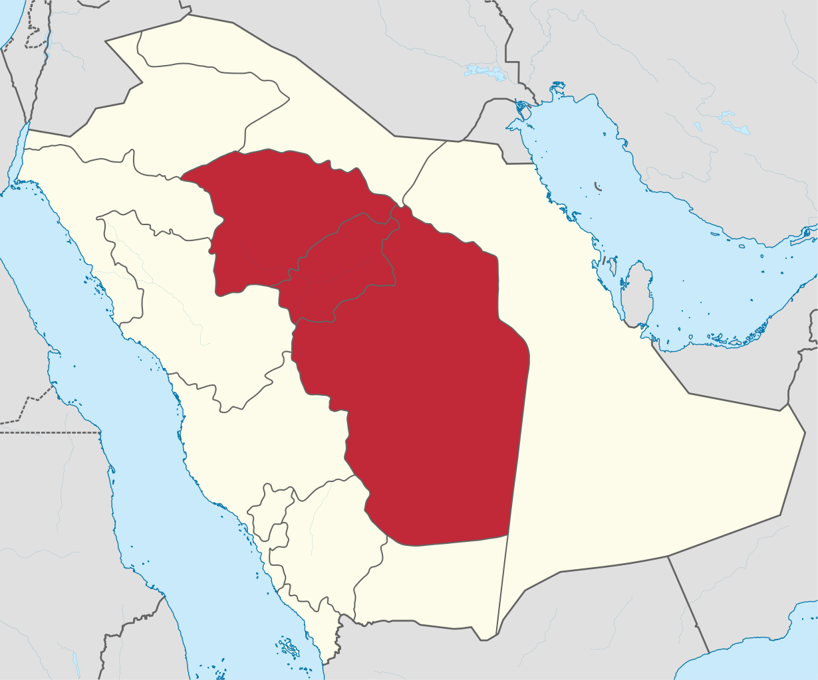
Muhammad ibn Abd al-Wahhab 1703-1792
From Najd in Arabia
No European colonisation
Not even conquered by Ottoman Turks
Religious revivalist
Inspired raids to kill Shias
Slide 66

Slide 67
Antidotes to religious extremism
Learning more history
  Past bad behaviour from all sides
  Past good behaviour from all sides
  Avoid demonization
Learning more religion
  Textual interpretations have differed widely
  Independent thinking about texts
  Does God really need your help?
Slide 67

Slide 68
The Constitution of Medina
THE MEDINA CHARTER
622 C.E.
In the name of God the Compassionate, the Merciful.
Slide 68

Slide 69
Muslims and their allies
(1) This is a document from Muhammad the prophet (governing the relations) between the believers and Muslims of Quraysh and Yathrib, and those who followed them and joined them and labored with them.
Slide 69

Slide 70
One community
(2) They are one community (umma) to the exclusion of all men.
(3) The Quraysh emigrants according to their present custom shall pay the bloodwit within their number and shall redeem their prisoners with the kindness and justice common among believers.
Slide 70

Slide 71
Various tribes
(4-8) The B. ‘Auf according to their present custom shall pay the bloodwit they paid in heatheism; every section shall redeem its prisoners with the kindness and justice common among believers. The B. Sa ida, the B. ‘l-Harith, and the B. Jusham, and the B. al-Najjar likewise.
(9-11) The B. ‘Amr b. ‘Auf, the B. al-Nabit and the B. al-‘Aus likewise.
Slide 71

Slide 72
Obligations on Muslims
(12)(a) Believers shall not leave anyone destitute among them by not paying his redemption money or bloodwit in kindness.
(12)(b) A believer shall not take as an ally the freedman of another Muslim against him.
Slide 72

Slide 73
Avoid sin or injustice
(13) The God-fearing believers shall be against the rebellious or him who seeks to spread injustice, or sin or animosity, or corruption between believers; the hand of every man shall be against him even if he be a son of one of them.
(14) A believer shall not slay a believer for the sake of an unbeliever, nor shall he aid an unbeliever against a believer.
Slide 73

Slide 74
Protection to Muslims and Jews
(15) God’s protection is one, the least of them may give protection to a stranger on their behalf. Believers are friends one to the other to the exclusion of outsiders.
(16) To the Jew who follows us belong help and equality. He shall not be wronged nor shall his enemies be aided.
Slide 74

Slide 75
Peace is indivisible
(17) The peace of the believers is indivisible. No separate peace shall be made when believers are fighting in the way of God. Conditions must be fair and equitable to all.
(18) In every foray a rider must take another behind him.
(19) The believers must avenge the blood of one another shed in the way of God.
Slide 75

Slide 76
Prohibition of murder
(20)(a) The God-fearing believers enjoy the best and most upright guidance.
(20)(b) No polytheist shall take the property of person of Quraysh under his protection nor shall he intervene against a believer.
(21) Whoever is convicted of killing a believer without good reason shall be subject to retaliation unless the next of kin is satisfied (with blood-money), and the believers shall be against him as one man, and they are bound to take action against him.
Slide 76

Slide 77
Do not help the evil
(22) It shall not be lawful to a believer who holds by what is in this document and believes in God and the last day to help an evil-doer or to shelter him. The curse of God and His anger on the day of resurrection will be upon him if he does, and neither repentance nor ransom will be received from him.
Slide 77

Slide 78
Shared costs of war
(23) Whenever you differ about a matter it must be referred to God and to Muhammad.
(24) The Jews shall contribute to the cost of war so long as they are fighting alongside the believers.
Slide 78

Slide 79
Freedom of religion
(25) The Jews of the B. ‘Auf are one community with the believers (the Jews have their religion and the Muslims have theirs), their freedmen and their persons except those who behave unjustly and sinfully, for they hurt but themselves and their families.
Slide 79

Slide 80
Extends to allies of Jews
(26-35) The same applies to the Jews of the B. al-Najjar, B. al-Harith, B. Sai ida, B. Jusham, B. al-Aus, B. Tha'laba, and the Jafna, a clan of the Tha‘laba and the B. al-Shutayba. Loyalty is a protection against treachery. The freedmen of Tha ‘laba are as themselves. The close friends of the Jews are as themselves.
Slide 80

Slide 81
No unauthorised fighting
(36) None of them shall go out to war save the permission of Muhammad, but he shall not be prevented from taking revenge for a wound. He who slays a man without warning slays himself and his household, unless it be one who has wronged him, for God will accept that.
Slide 81

Slide 82
Shared costs and consultation
(37) The Jews must bear their expenses and the Muslims their expenses. Each must help the other against anyone who attacks the people of this document. They must seek mutual advice and consultation, and loyalty is a protection against treachery. A man is not liable for his ally’s misdeeds. The wronged must be helped.
(38) The Jews must pay with the believers so long as war lasts.
Slide 82

Slide 83
Medina a sanctuary
(39) Yathrib [Medina] shall be a sanctuary for the people of this document.
(40) A stranger under protection shall be as his host doing no harm and committing no crime.
(41) A woman shall only be given protection with the consent of her family.
Slide 83

Slide 84
Arbitration by the Prophet
(42) If any dispute or controversy likely to cause trouble should arise it must be referred to God and to Muhammad the apostle of God. God accepts what is nearest to piety and goodness in this document.
Slide 84

Slide 85
No assistance to the enemy
(43) Quraysh and their helpers shall not be given protection.
(44) The contracting parties are bound to help one another against any attack on Yathrib.
Slide 85

Slide 86
Mutual support, Jews and Muslims
(45)(a) If they are called to make peace and maintain it they must do so; and if they make a similar demand on the Muslims it must be carried out except in the case of a holy war.
(45)(b) Every one shall have his portion from the side to which he belongs.
Slide 86

Slide 87
Status of non-allied Jews
(46) The Jews of al-Aus, their freedmen and themselves have the same standing with the people of this document in purely loyalty from the people of this document. Loyalty is a protection against treachery. He who acquires ought acquires it for himself. God approves of this document.
(47) This deed will not protect the unjust and the sinner. The man who goes forth to fight and the man who stays at home in the city is safe unless he has been unjust and sinned. God is the protector of the good and God-fearing man and Muhammad is the apostle of God.
Slide 87

Slide 88
Source
This text is taken from A. Guillaume, The Life of Muhammad — A Translation of Ishaq's Sirat Rasul Allah, Oxford University Press, Karachi, 1955; pp. 231-233. Numbering added.
From www.constitution.org/cons/medina/con_medina.txt
Slide 88

Slide 89
Bibliography
Slide 89

Slide 90
Quran
“The Qur’an – a new translation" by MAS Abdel Haleem
“The message of the Qur’an” by Muhammad Asad
“The Study Quran – a new translation and commentary” by Seyyed Hossain Nasr & team
“Abrogation in the Qur'an and Islamic Law” by Louay Fatoohi
Slide 90

Slide 91
Hadith
"A Textbook of Hadith Studies: Authenticity, Compilation, Classification and Criticism of Hadith" by Mohammad Hashim Kamali
"Authentication of Hadith — Redefining the Criteria" by Israr Ahmad Khan
“The Canonization of al-Bukhari and Muslim: The Formation and Function of the Sunni Hadith Canon” by Jonathan Brown
Free, large hadith collection: University of Southern California’s Center for Muslim-Jewish Engagement
  http://cmje.usc.edu/religious-texts/hadith/
Slide 91

Slide 92
Islam generally
“Muhammad: His Life Based on the Earliest Sources” by Martin Lings
“Islam – Past, Present & Future” by Hans Kung
“Principles of Islamic Jurisprudence” by Mohammad Hashim Kamali
"Islamic Law - Theory and Interpretation" by Michael Mumisa
"Qur’anic Concepts of the Ethics of Warfare: Challenging the Claims of Islamic Aggressiveness" by Joel Hayward
“Salafi-Jihadism: The History of an Idea” by Shiraz Maher
Slide 92

Slide 93
Q & A
Slide 93

