Slide 1
How Britain has changed in my lifetime
Tytherington School
Mohammed Amin MBE FRSA MA FCA AMCT CTA(Fellow)
4 May 2018

Slide 2
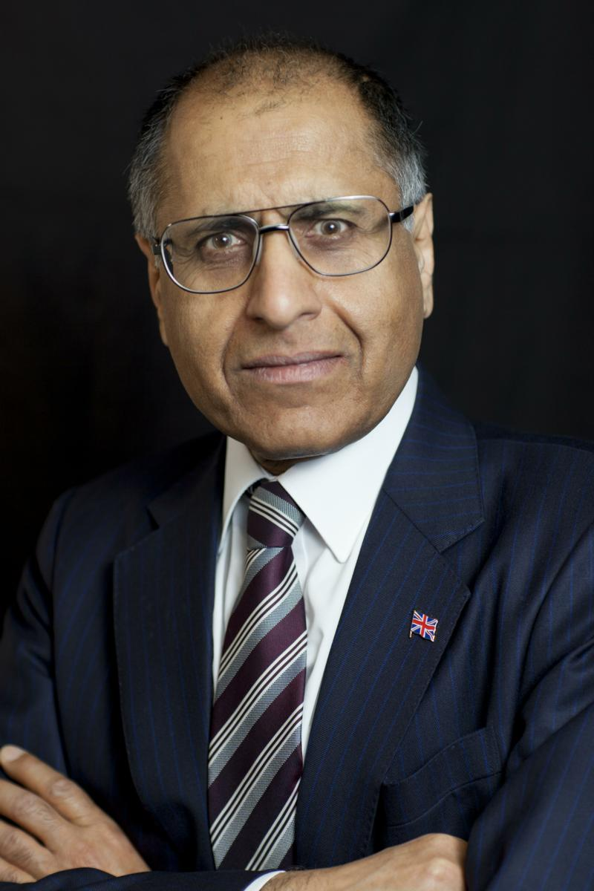
Mohammed Amin
Mohammed Amin was born in 1950 in Pakistan but has lived in Manchester since 1952.
He graduated in mathematics from Cambridge University and before retirement was a tax partner in PricewaterhouseCoopers.
He believes everyone can help to make the world a better place.
  His writings and presentations about a wide range of subjects can be found on his personal website.
www.mohammedamin.com
Slide 2

Slide 3
Synopsis
Economic change
Education levels
Technology
Television
Travel
Ethnic diversity
Religious diversity
The UK’s sense of self
Q&A
Slide 3

Slide 4
Economic change
Slide 4

Slide 5
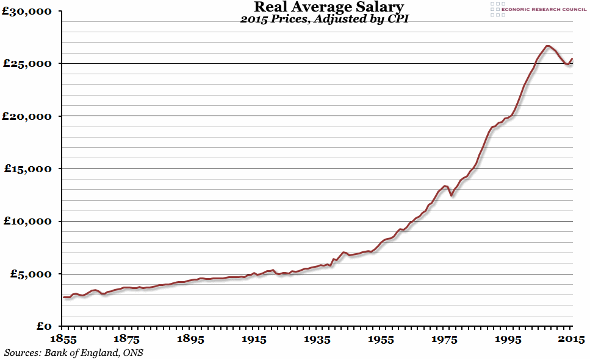
UK Real average salary per capita
Slide 5

Slide 6
My first calculator
1974
  Four functions, one memory
  £40 in 1974 money
  Equivalent in 2017 money, RPI adjusted, = £375
2018
  Nobody buys calculators
Website article “Richer than Pharaoh?”
  MA v Rameses II
Slide 6

Slide 7
Education levels
Slide 7

Slide 8
Higher education participation
1950 (UK) | 3.4%
2015 (England) | 49.3%
Slide 8

Slide 9
Technology
Slide 9

Slide 10
What I wanted as a teenager
Computer terminal in my bedroom
Connected via a cable to a large computer with the world’s information
Availability in 1960’s?
Cost?
What would be the price of my iPhone in 1990?
Slide 10

Slide 11
Biological knowledge
Structure of DNA identified 1953
Human Genome Project, 15 years, cost ~ $3bn
2017 price ~ $1,000 per human genome
CRISPR-Cas9 ability to edit DNA
Slide 11

Slide 12
Television
Slide 12

Slide 13
Explosion of choice
Year | Channels | Viewer control
1950 | 1
1955 | 2
1964 | 3
1975 |  | Video cassette recorders
1982 | 4
1989 | Sky TV launched
2018 | 1,000+ | Digital recorders. Internet TV. Catch-up services.
Slide 13

Slide 14
Travel
Slide 14

Slide 15
Britons travelling abroad
1950 | 1 m foreign holidays
2016 | 70.6 m foreign trips
Slide 15

Slide 16
Amin family
MA landed in UK 1952
First overseas travel 1981
Children globetrotters
Slide 16

Slide 17
Why travel matters
UK is an “insula”
Most Briton’s attitudes were insular
The younger generation is different
Slide 17

Slide 18
Ethnic diversity
Slide 18

Slide 19
UK demographics
1950 = virtually all white
2011 England & Wales census below
Category | Number | %
White | 48,209,395 | 86.0
Mixed race | 1,224,400 | 2.2
Asian | 4,213,531 | 7.5
Afro-Caribbean | 1,864,890 | 3.3
Other | 563,696 | 1.0
 | 56,075,912 | 100.0
Slide 19

Slide 20
Religious diversity
Slide 20

Slide 21
UK religious composition 1950
Hard data difficult
Overwhelmingly Christian
  Mainly Church of England
  Sizeable other Protestant denominations
  Roman Catholics
Jews the only significant non-Christian minority
Other religions tiny
Some atheists
Slide 21

Slide 22
England & Wales 2011 census
Group | Number | %
Christian | 33,243,175 | 59.3
No religion | 14,097,229 | 25.1
Not answered | 4,038,032 | 7.2
Muslim | 2,706,066 | 4.8
Hindu | 816,633 | 1.5
Sikh | 423,158 | 0.8
Jewish | 263,346 | 0.5
Buddhist | 247,743 | 0.4
Other | 240,530 | 0.4
 | 56,075,912 | 100.0
Slide 22

Slide 23
The UK’s sense of self
Slide 23

Slide 24
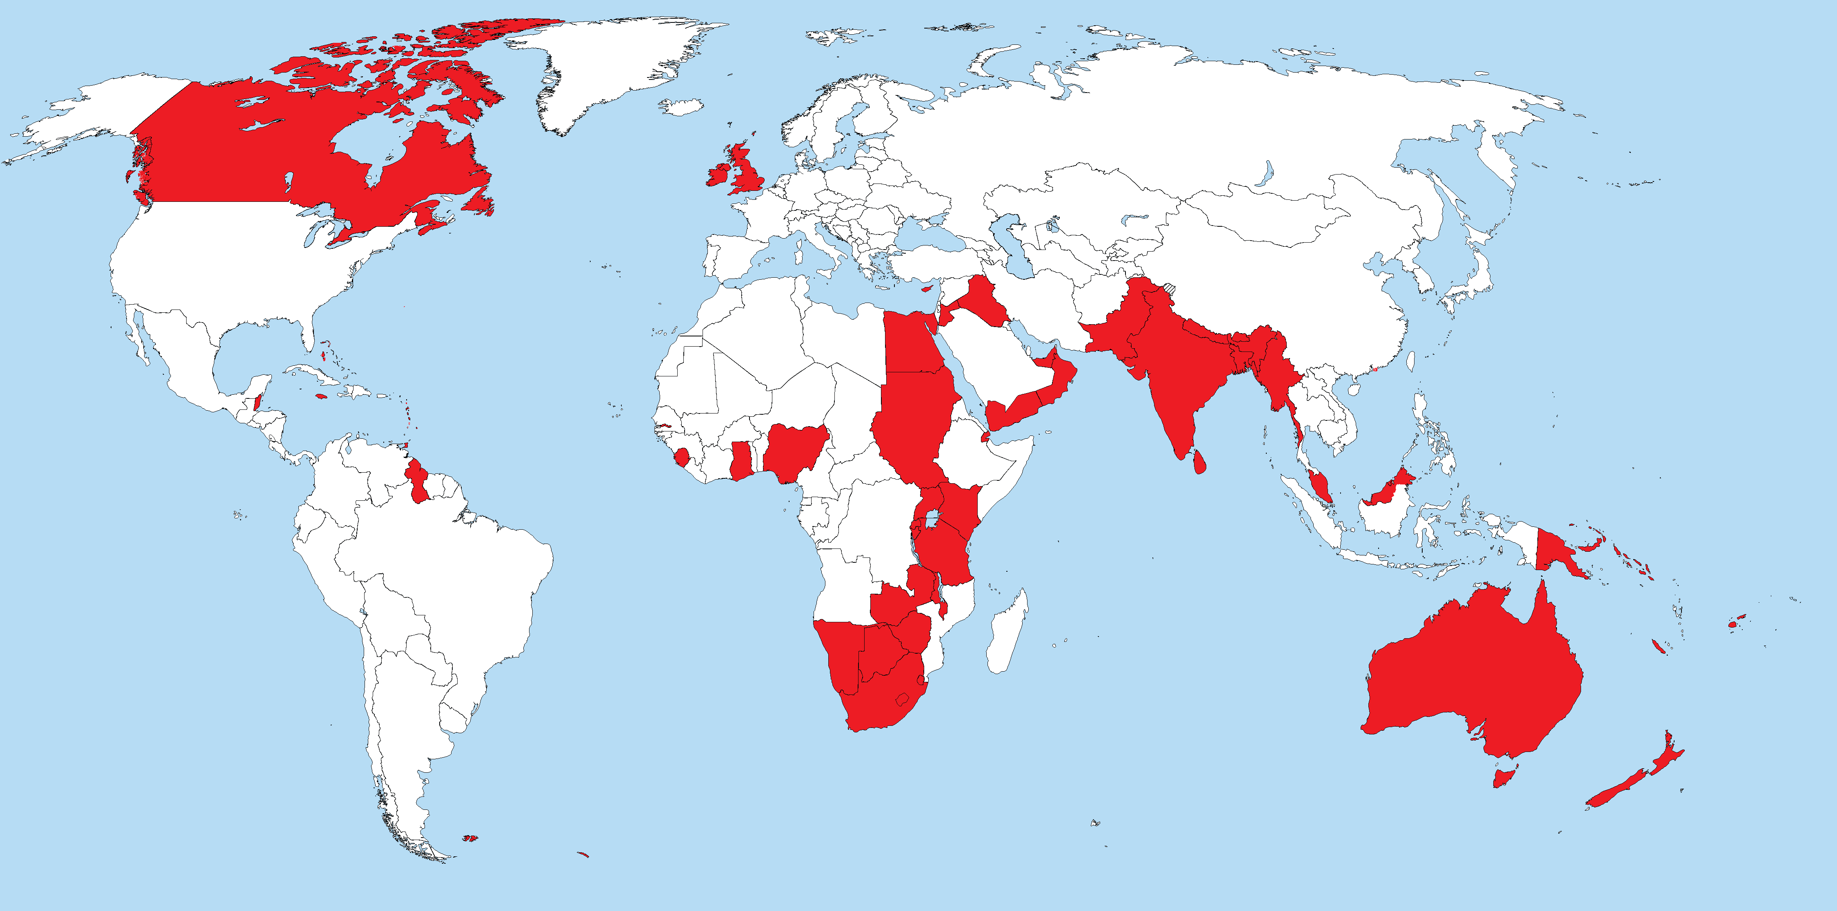
British Empire 1919-1939
Slide 24

Slide 25
British Empire statistics
1922 Empire population ~ 458 million = 25% of planet
1922 Empire area ~ 33.7 m km² = ~ 25% of planet
Largest empire in history
Slide 25

Slide 26
UK 2018
Important country
  Nuclear weapons state
  UNSC Permanent Member
  Massive soft power
GDP rank 5 (after USA, China, Japan, Germany) but about to be overtaken by India.
Population rank 21
World dominated by others to increasing extent
Slide 26

Slide 27
Compared to 1950, Britons today are…
Far better educated
Know the world far better
Much richer
Much healthier
Much longer lived
More diverse
  like the rest of the world
Slide 27

Slide 28
Q & A
Slide 28

