Slide 1
Do Muslim Religious Texts Cause Religious Persecution?
BYU International Center for Law and Religion Studies
24th Annual International Law and Religion Symposium
Religion and Religious Freedom in a Changing World
Mohammed Amin MBE
October 2017

Slide 2
Outline
The speaker
Texts:
  Quran
  Hadith
Historical perspective
Sources of persecution:
  External
  Internal
Remedies
Slide 2

Slide 3
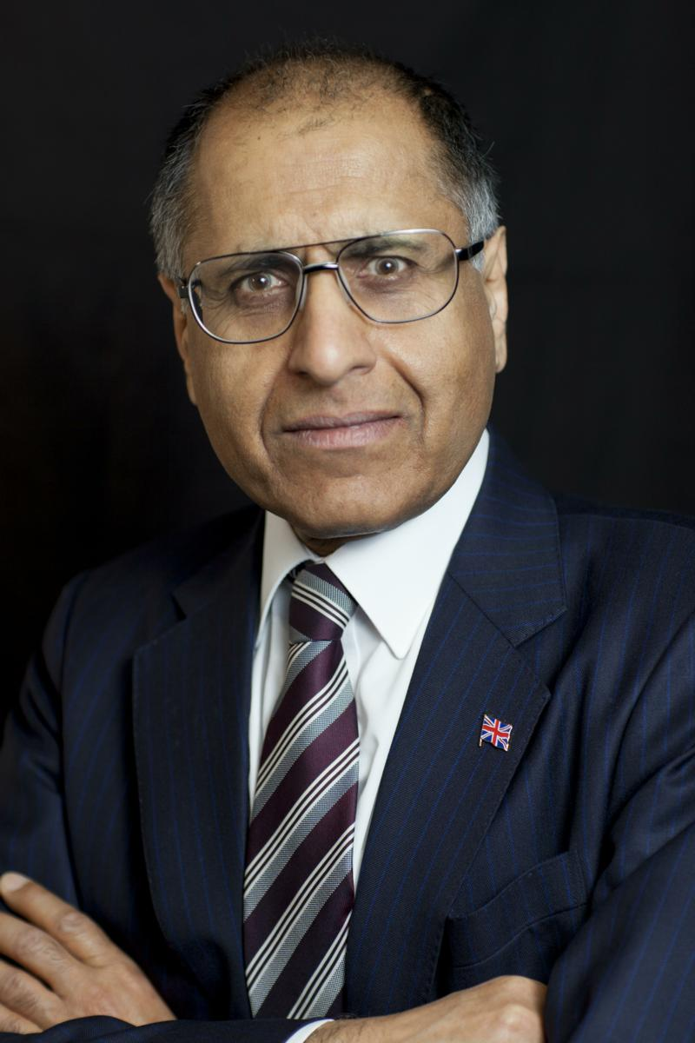
Mohammed Amin MBE
Mohammed Amin has lived in the UK since the age of 2. He graduated in mathematics from Cambridge University and before retirement was a tax partner in PricewaterhouseCoopers.
Amongst other things, he is:
  Co-Chair of the Muslim Jewish Forum of Greater Manchester
  Chairman of the Conservative Muslim Forum, part of the Conservative Party
  A patron and Chairman of Curriculum for Cohesion
  In April 2016 he gave the 2nd Annual Religious Freedom Lecture of the J. Reuben Clark Law Society UK and Ireland Chapter:
  “One Muslim’s Perspective on Religious Freedom.”
  The lecture and his other writings on religion are on his website mohammedamin.com
Slide 3

Slide 4
Texts
Quran
Slide 4

Slide 5
Origin of the Quran
Quran
Archangel Gabriel
Prophet Muhammad
God
Slide 5

Slide 6
Avoid Jewish and Christian friends
O ye who believe! Take not the Jews and the Christians for friends. They are friends one to another.
He among you who taketh them for friends is (one) of them. Lo! Allah guideth not wrongdoing folk.
Quran 5:51 – Marmaduke Pickthall translation
Slide 6

Slide 7
Texts
Hadith
Slide 7

Slide 8
Origins of Hadith
Hadith
Prophet Muhammad
Muslim Observers
Hadith Collectors
Slide 8

Slide 9
Background to Hadith
Prophet discouraged writing of his sayings
  Avoid confusion with Quran
Collected long after his death
Scholars emphasise the chain of transmission (isnad)
  Strongest hadith have multiple parallel chains of reliable transmitters
  Some hadith have solitary chains, or weak links
All scholars recognise that hadith are of varying reliability
“Laity” often taught all hadith in the two main collections are totally reliable
Slide 9

Slide 10
Conflict with Jews at end of time
Allah's Apostle said,
"The Hour will not be established until you fight with the Jews, and the stone behind which a Jew will be hiding will say:
"O Muslim! There is a Jew hiding behind me, so kill him."
Bukhari Volume 4, Book 52, Number 177
Slide 10

Slide 11
Quoted today
The Prophet, Allah bless him and grant him salvation, has said:
"The Day of Judgement will not come about until Moslems fight the Jews (killing the Jews), when the Jew will hide behind stones and trees. The stones and trees will say O Moslems, O Abdulla, there is a Jew behind me, come and kill him. Only the Gharkad tree, (evidently a certain kind of tree) would not do that because it is one of the trees of the Jews." (related by al-Bukhari and Moslem).
Hamas Covenant of 1988, extract from Article 7
http://avalon.law.yale.edu/20th_century/hamas.asp
Slide 11

Slide 12
Historical perspective
Slide 12

Slide 13
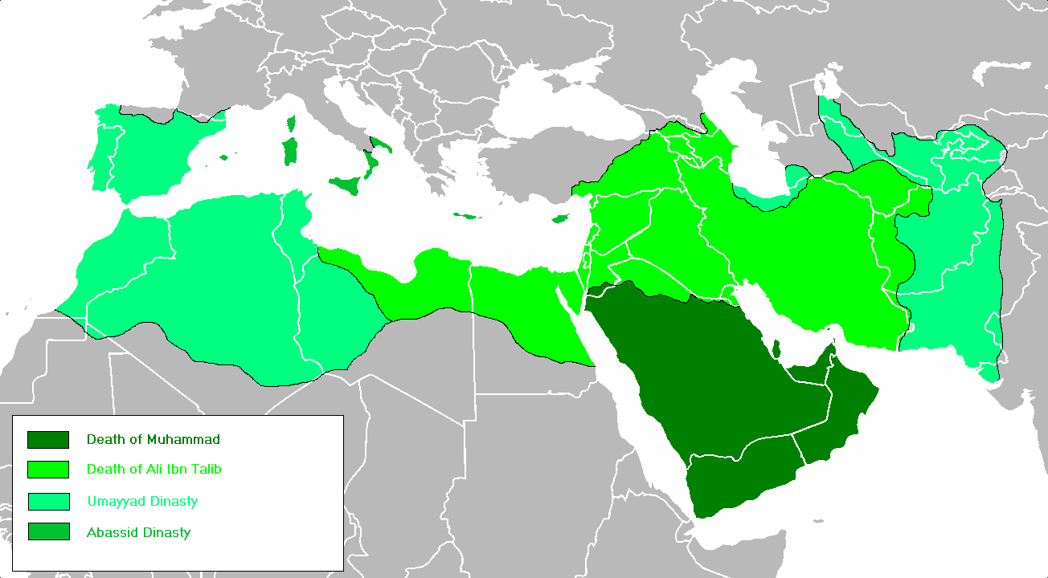
The Arab Empire - Wikimedia Commons
Slide 13

Slide 14
Jewish refugees to Israel 1947-1957
Country | Refugees
Morocco | 260,000
Iraq | 129,290
Yemen and Aden | 50,552
Tunisia | 56,000
Algeria | 14,000
Iran | 31,000
Source: "In Ishmael’s House – A History of Jews in Muslim Lands" by Martin Gilbert
Slide 14

Slide 15
Christians in Middle East - Wikipedia
Country | Number
Egypt | 12-16 million in 2008 per Coptic claims
Iraq | About 1.6 million in 2003
Lebanon | Last official census 1932, Christians were 51%
Syria | 1.2 million in 1960 census
Slide 15

Slide 16
Sources of persecution
External
Slide 16

Slide 17
French colonisation of Algeria
Annexed as a department of metropolitan France
Algerian Christians and Jews given French citizenship
  NOT Algerian Muslims
Classic divide and rule
Consequences post independence?
Attitudes of Muslim immigrants in France of Algerian origin?
Slide 17

Slide 18
Egypt 1928
Officially independent
Unofficially puppet state under British control
Founding of Muslim Brotherhood by Hassan al-Banna 1928
  One of two intellectual antecedents of Al Qaeda and ISIS
Slide 18

Slide 19
India under British Empire
Longstanding divide and rule approach to Indian religious groups
Writings on Islam by Abul A'la Maududi (1903 – 1979)
  Founded Jamaat-e-Islami 1941
  Fashionable contemporary ideologies: Fascism, Bolshevism
    Maududi created an Islamic version
  The other intellectual antecedent of Al Qaeda and ISIS
Slide 19

Slide 20
Sources of persecution
Internal
Slide 20

Slide 21
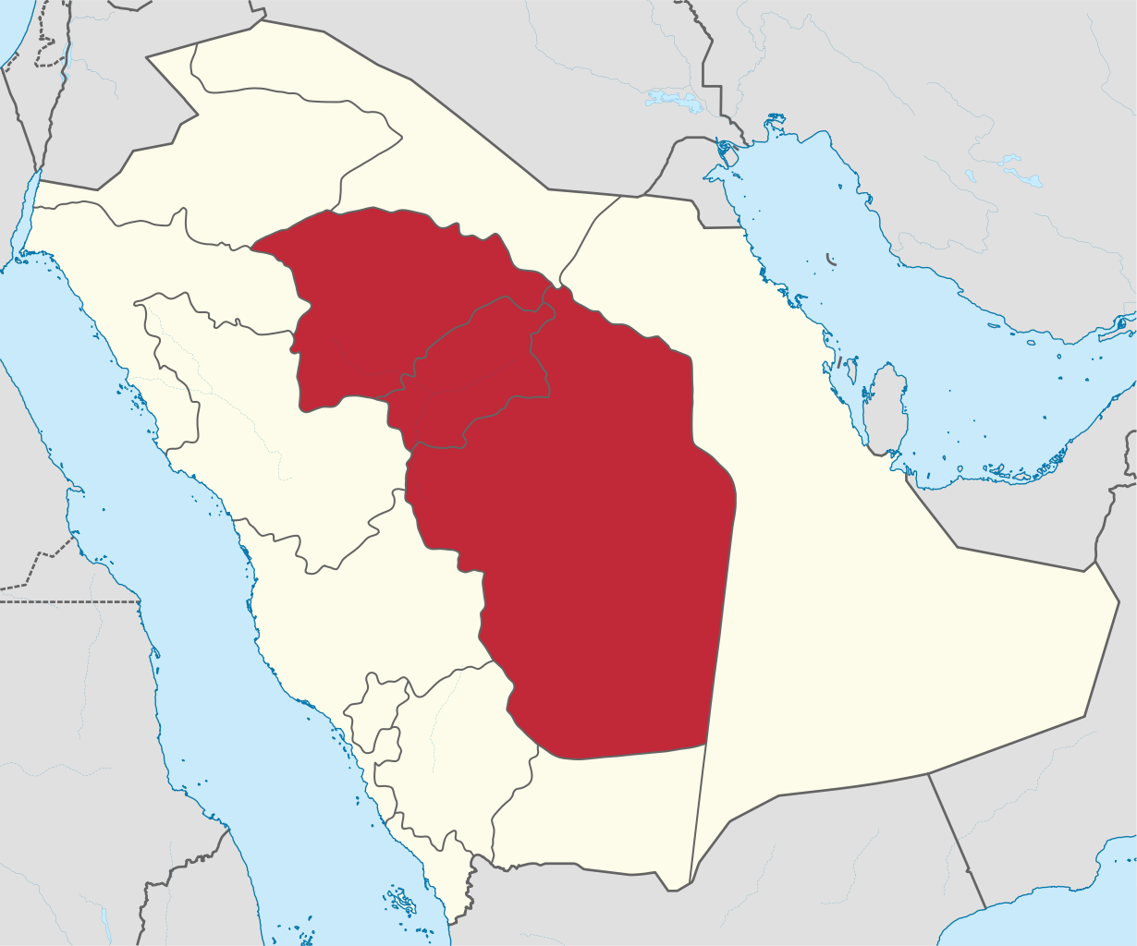
Muhammad ibn Abd al-Wahhab 1703-1792
From Najd in Arabia
No European colonisation
Not even conquered by Ottoman Turks
Religious revivalist
Inspired raids to kill Shias
Slide 21

Slide 22
Remedies
Slide 22

Slide 23
Antidotes to religious extremism
Learning more history
  Past bad behaviour from all sides
  Past good behaviour from all sides
  Avoid demonization
Learning more religion
  Textual interpretations have differed widely
  Independent thinking about texts
  Does God really need your help?
Slide 23

Slide 24
Q & A
Slide 24

