Slide 1
Effective Corporate Governance and the Independence of the Board Audit Committee
Third International Corporate Governance Conference
Alfaisal University, Riyadh, Kingdom of Saudi Arabia
Mohammed Amin MBE FRSA MA FCA AMCT CTA(Fellow)
22 December 2021

Slide 2
Outline
Disclaimer
The speaker
Ownership structures
Governance challenges
Solution requirements
Q & A
2

Slide 3
Disclaimer
Mohammed Amin is chairman, or a member of the senior leadership team, of many organisations, listed on his website.
He is speaking in a purely personal capacity.
None of his comments should be taken as indicating the views of any organisation he is involved with.
3

Slide 4
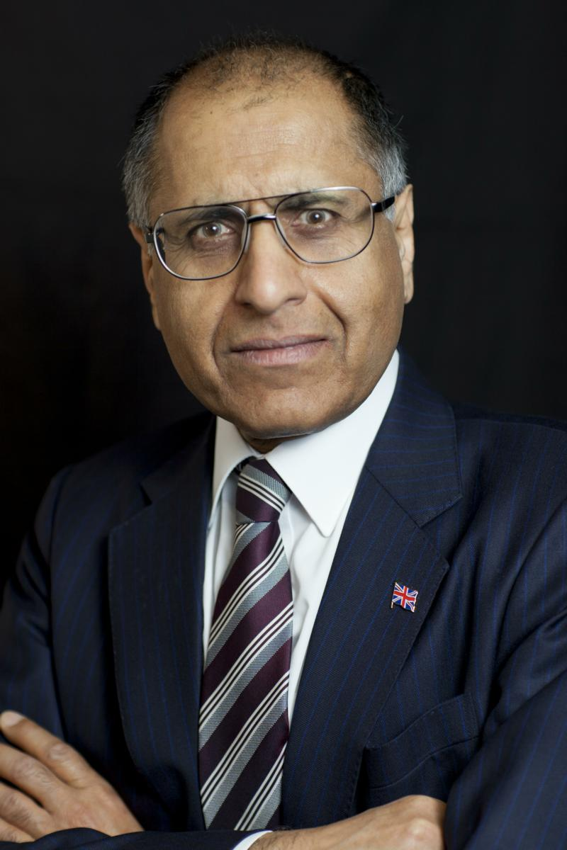
Mohammed Amin
A Price Waterhouse (now PwC) tax partner 1990-2009, he attended many audit committee meetings as part of the PwC audit team.
His client-side experience comes from serving on the audit committees of Salford University, Manchester Training & Enterprise Council, and PwC itself as a member of PwC’s Supervisory Board.
He also has extensive experience of corporate governance in non-commercial organisations.
His writings on finance are on his website: www.mohammedamin.com
4

Slide 5
Ownership structures
5

Slide 6
Single remote owner
Remote 100% owner
Appoints non-executive directors
Non-executive directors responsible to
Non-executive directors
Auditor
Communicate to protect owner’s interests
Executive directors
Staff
6

Slide 7
Several large shareholders
Remote 30% owner
Remote 40% owner
Remote 30% owner
Owners appoint non-executive directors.
Sometimes one non-executive per major owner.
Non-executives responsible to owners.
Non-executive directors
Auditor
Communicate to protect owners’ collective interests
Executive directors
Staff
7

Slide 8
One preponderant shareholder + public
55% owner (Remote or otherwise)
Many small public shareholders
Risks:
Management misbehaviour
55% extracting disproportionate benefits from company
Non-executive directors
Auditor
Communicate to protect owners’ collective interests
Preventing (2) is non-executives’ most important task
Executive directors
Staff
8

Slide 9
Small public shareholders only
Many small public shareholders
Risks:
Shareholders’ voting apathy
Dominance by management
Non-executive directors
Auditor
Preventing (2) is non-executives’ most important task
Communicate to protect owners’ collective interests
Executive directors
Staff
9

Slide 10
Q&A
10

