Slide 1
Combating anti-Muslim hatred: the role of law and society
The Muslim Jewish Forum of Greater Manchester
Mohammed Amin
Co-Chair
29 November 2020

Slide 2
Synopsis
The speaker
Bad attitudes and bad behaviours
The role of law
What you can do to combat
Old anti-Muslim attitudes
New anti-Muslim attitudes
2

Slide 3
The speaker
3

Slide 4
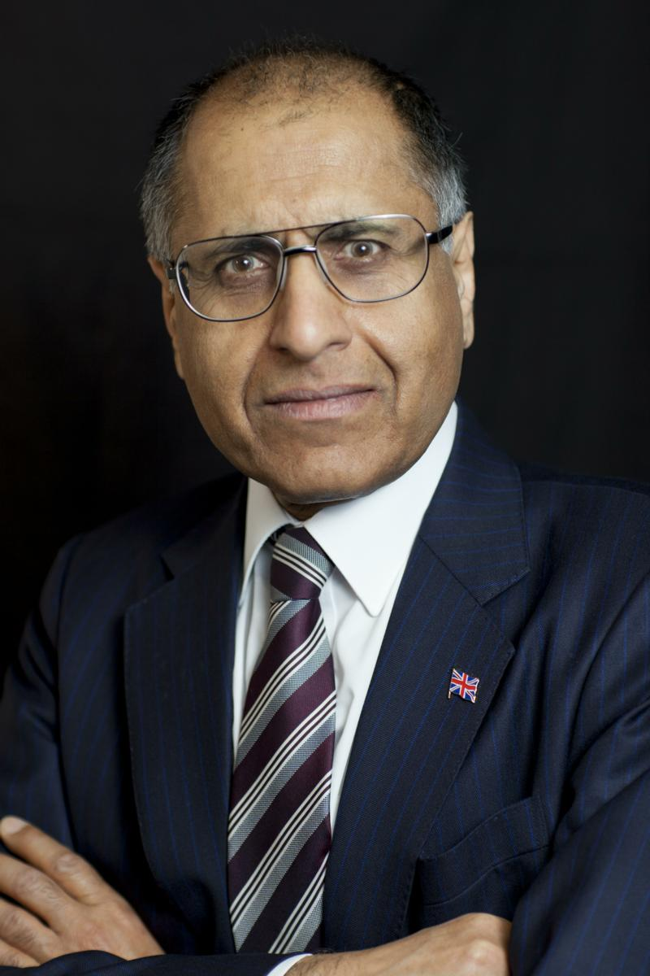
Mohammed Amin
Mohammed Amin has lived in Manchester since the age of 2. For his background, visit www.mohammedamin.com
Amongst other things, he is:
Co-Chair of the Muslim Jewish Forum of Greater Manchester
Chairman of the Islam & Liberty Network, based in Kuala Lumpur
The views presented are his own.
They should not be ascribed to either MJF or ILN.
4

Slide 5
Bad attitudes and bad behaviours
5

Slide 6
Range of bad behaviours
I won’t invite Muslims to my home
I won’t employ a Muslim
Anti-Muslim incitement
Genocide
6

Slide 7
Behaviours come from attitudes
Bad attitudes
Bad deeds
Bad deeds
Cannot read minds
Can
change minds
Role of society
Role of law
7

Slide 8
The role of law
8

Slide 9
I won’t employ a Muslim
Equality Act 2010
10 protected characteristics
Religion or belief (section 10)
Many behaviours unlawful
Discrimination in provision of services to the public and public functions
Disposal of premises
Employment
etc
9

Slide 10
Incitement of racial / religious hatred
Racial hatred incitement came first
Public Order Act 1986 Part III s.17-29
Requires “intent” (like most crimes)
Religious hatred added later
By Racial and Religious Hatred Act 2006 amending POA 1986.
New Part 3A
Key provisions to protect religious freedom
10

Slide 11
Protecting religious freedom: POA 1986 s.29J
Nothing in this Part shall be read or given effect in a way which prohibits or restricts discussion, criticism or expressions of antipathy, dislike, ridicule, insult or abuse of particular religions or the beliefs or practices of their adherents, or of any other belief system or the beliefs or practices of its adherents, or proselytising or urging adherents of a different religion or belief system to cease practising their religion or belief system.
11

Slide 12
Precise distinctions needed
Attacking
Muslims
Attacking
Islam
A crime
Not a crime
May be socially unacceptable
Depends on your social circle
12

Slide 13
Do we need new laws?
No
Discrimination
Equality Act 2010 is fine
Needs better enforcement
Inciting hatred against Muslims
Already a crime
Slagging off Islam is no different to slagging off Christianity
Precise analysis sometimes needed
When does anti-Islam language disguise anti-Muslim hatred?
13

Slide 14
Outside the scope of law
I refuse to make friends with Muslims
I refuse to vote for a Muslim politician
I refuse to socialise with Muslims
etc
Mission of Muslims + right thinking non-Muslims:
change people’s attitudes.
14

Slide 15
What you can do to combat
Old anti-Muslim attitudes
15

Slide 16
Condensed European history
Hegemonic Christian Church (Roman Catholic, Orthodox, + later Protestant)
Internal hostility to Jews and Judaism
External threat from Muslims and Islam
Arab conquests
Ottoman Turks in SE Europe, “Gates of Vienna” 1683
16

Slide 17
Learn and share more accurate history
Muslims’ contribution to world civilisation
Long history of Arab / Christian collaboration and mutual learning
When Ottomans besieged Vienna
Christians fought on both sides
Muslims fought on both sides
History is not a simple US vs THEM
17

Slide 18
Use inclusive language
Replace | With
Allah | God
Isa | Jesus
Muslim world | Muslim majority countries
“We” = British Muslims | “We” = everybody in UK
18

Slide 19
Engage
Speak to schools
Write
Get involved on “non-Muslim” issues
When a Muslim speaks about tax policy or corporate governance, he or she is also sending out a powerful message:
“Muslims are normal British people” - often with expert knowledge
19

Slide 20
What you can do to combat
New anti-Muslim attitudes
20

Slide 21
Causes of new anti-Muslim attitudes
Muslims behaving badly
Non-Muslims’ reaction
“Death to Salman Rushdie”
9/11, 7/7, Bataclan …
Riots over Danish cartoons
ISIS enslaving Yazidi women
Killings at Charlie Hebdo
Celebrating Mumtaz Qadri, killer of Salman Taseer
Muslims act like savages
Muslims threaten our freedoms
Muslims danger to everybody
21

Slide 22
How Muslims should respond
Criticise Muslims who do wrong unequivocally
Muslims historically reluctant to criticise other Muslims
Any hedging, equivocation, taken as sympathy for the bad guys
Be honest that ISIS, Al Qaeda, 7/7 bombers motivated by their understanding of Islam
Denying this taken as trying to hide something about Islam
Reach a clear view on apparent clashes between traditional Islamic teachings and European liberalism, and be prepared to debate it
The challenge cannot be avoided
22

Slide 23
Every Muslim is an ambassador for Islam
Whether they want to be or not
23

